Slide 1
Writing Summaries 1
A CCU Writing Center Workshop

Slide 2
What is a Summary?
A shortened version of what someone else has written or said.
IMPORTANT: what has been written or said
Not: Your responses, value judgements, commentary, etc.
Objective and neutral

Slide 3
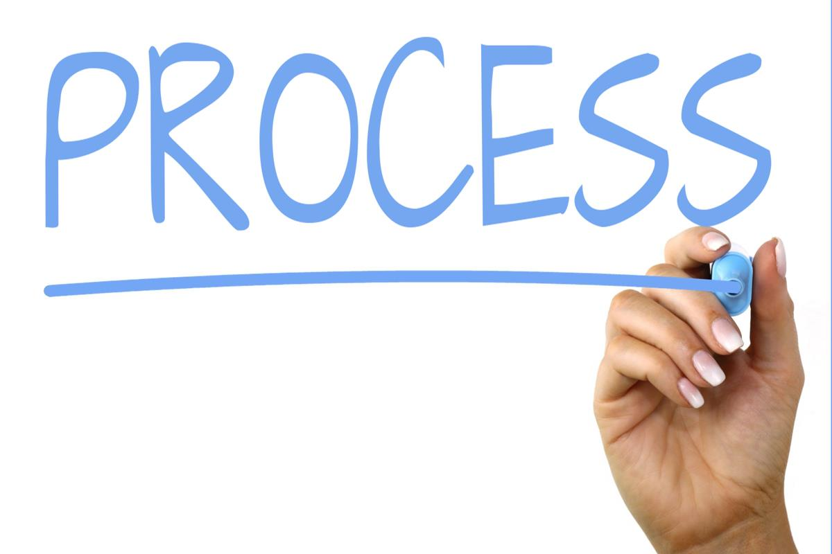
Four-Step Process
Read
Take notes
Draft
Revise/edit

Slide 4
Step 1: Read
Skim and scan (main ideas, major sections, headings)
Read closely
Skim and scan again

Slide 5
Step 2: Take Notes
Topic
Question
Main idea/thesis
Supporting ideas

Slide 6
Thank you!
Writing Center
www.coastal.edu/writingcenter
(843) 349-2937
writingcenter@coastal.edu

