Slide 1
Coastal Carolina University LIFE™ Program
http://www.coastal.edu/education/LIFE
Learning Is For Everyone!

Slide 2
What is LIFE™?
A tuition-based post-secondary education program for young adults who have mild to moderate intellectual disabilities.
Cohort structured program
Accepts 6 to 8 students each year during Fall semester only

Slide 3
Who should apply?
18-24 year olds
Identified as having a mild intellectual disability
Have exited high school with a certificate or non-standard diploma
Independently exhibit a desire and motivation to complete a post-secondary program

Slide 4
Admissions Criteria
Applicants must…
Demonstrate an interest and desire to pursue educational, employment, and life experiences through post-secondary education
Participate in a writing sample, with appropriate accommodations
Be willing to participate in research and promotional activities for LIFE™
Provide three letters of recommendation

Slide 5
Program Structure
Program course of study will be designed to duplicate a typical college schedule
Each student will participate in academics, work experiences, and campus activities based on individual interests and abilities
Each student will be entitled to a 504 plan
to ensure appropriate support and
accommodations / modifications
“Cruising Coastal” checklist allows for
various levels of independence across campus

Slide 6
Why CCU LIFE™?
Four-year program
Fully inclusive model with academic and social support
Dual enrollment option
Residence Life option
Includes a plan to transition to apartment living
Interagency and community collaboration
Internships and other work experiences
Supportive environment and campus culture

Slide 7
Why CCU LIFE™?
LIFE™ program and Career Services evaluation and career counseling
Basic academic skills needed for employment
Extracurricular activities and opportunities for socialization with age-appropriate peers
Community experiences
Builds self-advocacy, independence, and self-confidence

Slide 8
LIFE™ Program of Study
Specific program requirements (LIFE™ core courses)
Individualized according to student need and career interest
Full inclusion model with support and multiple internship opportunities

Slide 9
Freshman Year
Semester 1: 12 Credits
Semester 2: 12 Credits
Career Awareness and Foundations (3)
Independent Living and Social Developmental Course (3)
UNIV 110 First Year Experience (FYE) (3)
Elective Course of Student’s Choice (3)
Mandatory Academic Support and Tutoring Lab– Not for Credit
Career Awareness (Job Shadowing) (3)
Independent Living and Social Development Course (3)
UNIV 150 Career Exploration (3)
Elective Course of Student’s Choice (3)
Mandatory Academic Support and Tutoring Lab – Not for Credit

Slide 10
Sophomore Year
Semester 3: 12-15 Credits
Semester 4: 12-15 Credits
Career Apprenticeship (Internship on Campus) (3)
Independent Living and Social Development Course (3)
COMM 101 Introduction to Communication (3)
Major Academic Required Course (3)
Optional Elective Course of Student’s Choice (3)
Career Apprenticeship (Internship on Campus) (3)
Independent Living and Social Development Course (3)
HPRO 121 Personal and Community Health (3)
Major Academic Required Course(3)
Optional Elective Course of Student’s Choice (3)

Slide 11
Junior Year
Semester 5: 12-15 Credits
Semester 6: 12-15 Credits
Career Apprenticeship (Internship, on or off campus) (3-6)
Independent Living and Social Development Course (recommended) (3)
Major Academic Required Course(3)
Optional Elective Course of Student’s Choice (3)
Career Apprenticeship (Internship, on or off campus) (3-6)
Independent Living and Social Development Course (recommended) (3)
Major Academic Required Course(3)
Optional Elective Course of Student’s Choice (3)

Slide 12
Senior Year
Semester 7: 12-15 Credits
Semester 8: 12-15 Credits
Career Practicum (off campus) (6-9)
Career Practicum Seminar (3)
Transition Seminar (3)
Career Experience (off campus) (9-12)
Transition Seminar (3)

Slide 13
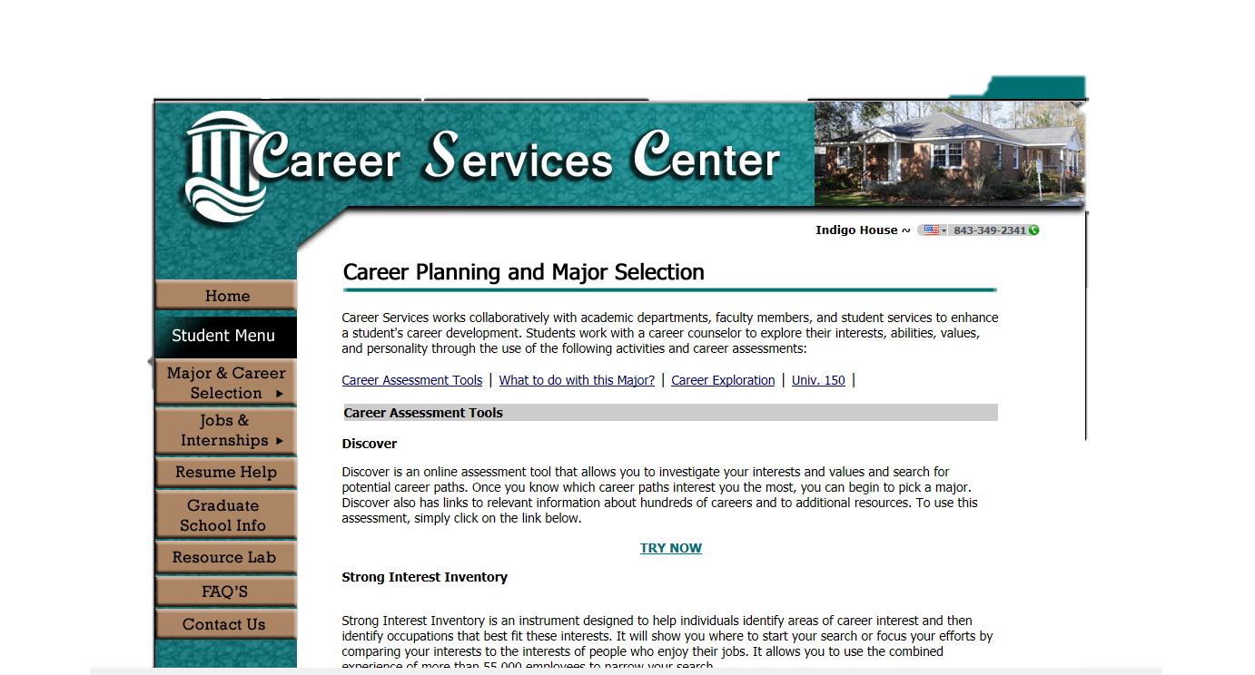
On-campus career assessment and counseling available

Slide 14
Student Learning Outcomes
Upon completion of the LIFE™ program, students will present a LIFE™ portfolio that documents their skills in the following areas:
Employment-related academics
Socialization
Independent living
Self-advocacy

Slide 15
Tuition & Fees (2012-2013)
Undergraduate
In-State per semester: $4,880
Undergraduate
Out-of-State per semester: $11,025

Slide 16
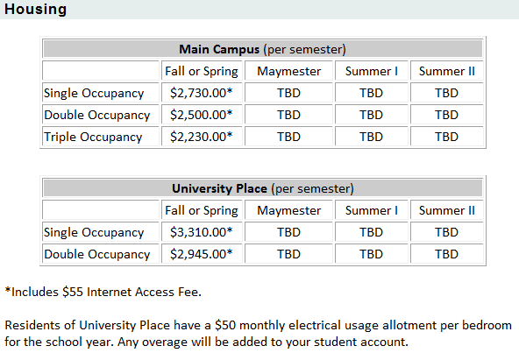
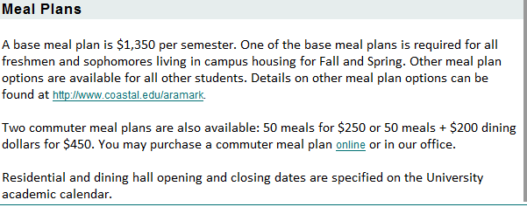
Semester Costs:
The Woods:
$2,230
University Place:
$2, 945
Meal Plan (on campus):
$1,350
Meal Plan (commuter):
$250 or $450

Slide 17
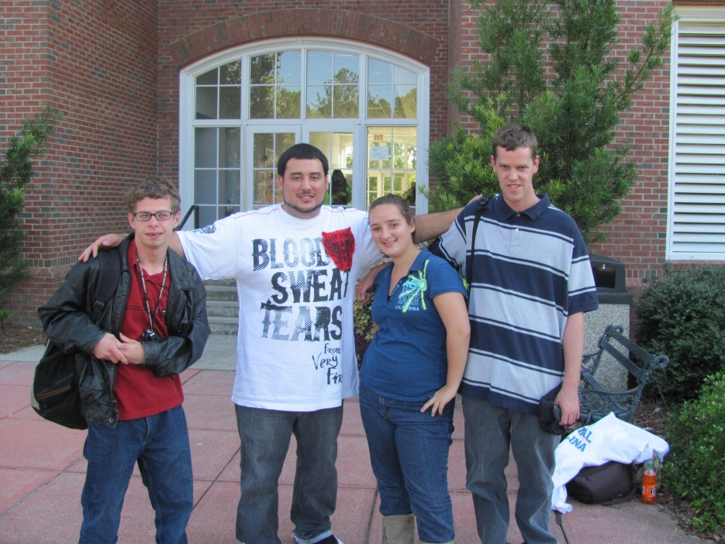
University Housing
Living in the residence halls is one of the most significant experiences students will have at Coastal Carolina University. Traditionally, students spend more time in their residence hall than anywhere else on campus. In their new homes they are challenged and educated by the diversity in thought as well as the cultural and intellectual exchange that surrounds them daily. By choosing university housing, students will join a community to expand their learning experience beyond the classroom. Resident students will have the opportunity to make new friends, develop an appreciation and respect for differences and learn important skills that will help personal and professional relationships through college and beyond.

Slide 18
Who will pay? What to ask and steps to follow…
Determine what parents and student can afford
Determine if additional revenue sources are needed; if so, complete the Free Application for Federal Student Aid (FAFSA); (Federal Pell Grant $5,500 maximum per academic year)
Check with your local Vocational Rehabilitation office to determine eligibility for financial support; Vocational Rehabilitation might pay for technology or tuition
Determine available cost-share methods and/or student scholarships
If the student is still receiving special education services in a public school, the Local Education Agency (LEA) can pay for transportation (if needed) and educational coaches
Disability Support Offices can provide tutoring or other academic accommodations, Developmental services agencies might pay for fees,
and the One-stop Career Centers can provide career preparation services (e.g., resume writing, job interviewing, job shadowing, internships, job placement). Collaboration with all available resources is key.
Adapted from Frequently Asked Questions, Think College, www.thinkcollege.net

Slide 19
http://www.coastal.edu/financialaid/FAFSA101.html

Slide 20
As a parent or teacher, what do I do now?
Make a plan!
Begin discussions about going to college at the middle level, or sooner if possible
Include college in the IEP and transition planning process
Seek community agency connections and support
Facilitate the development of self advocacy skills
Facilitate the completion of a functional curriculum that includes community work experiences and opportunities for practicing independent living skills
Investigate opportunities for financial support
Schedule a campus visit
ASK QUESTIONS!

Slide 21
Post Secondary Education Resources
Center for Disability Resources (CDR) http://uscm.med.sc.edu/cdrhome/postsecondaryeducation.html
College Transition Connection (CTC) http://collegetransitionconnection.org/
National Down Syndrome Society (NDSS) http://www.ndss.org/
ThinkCollege.net www.thinkcollege.net
Institute for Community Inclusion (ICI) www.communityinclusion.org

Slide 22
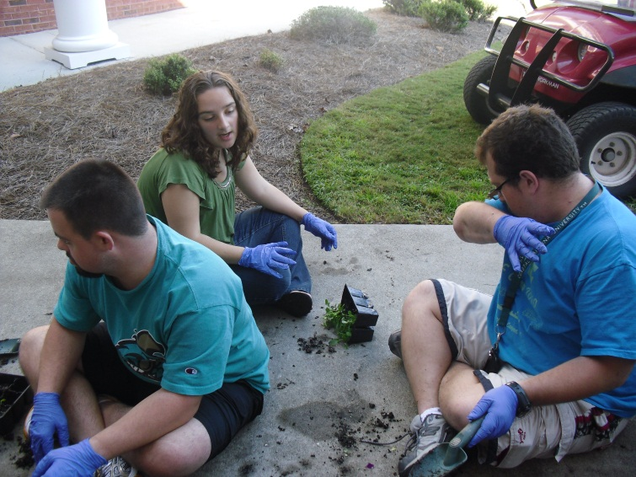
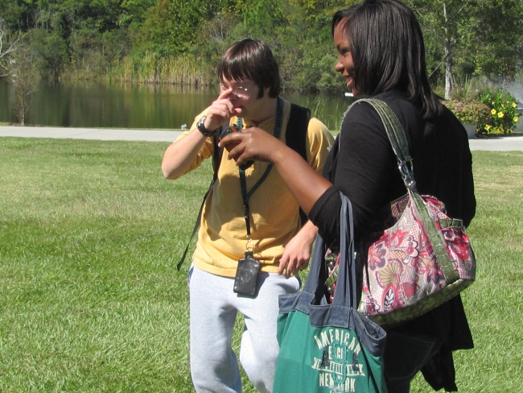
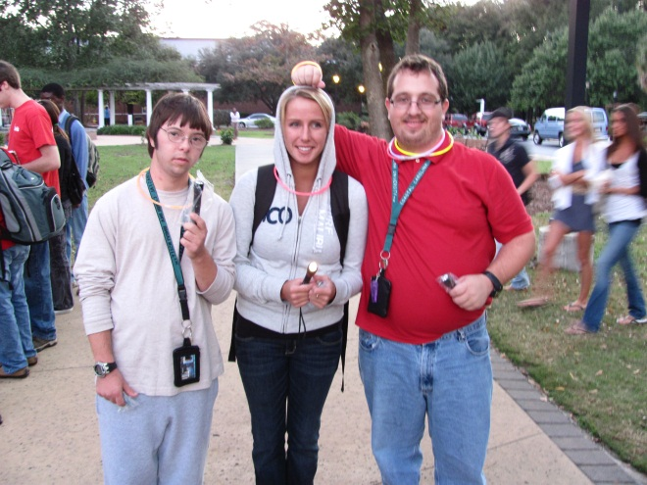
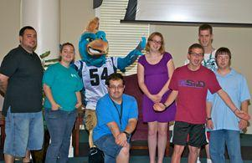
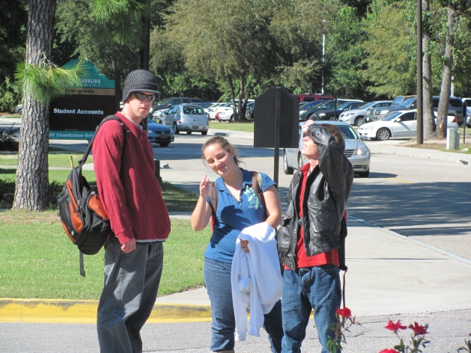
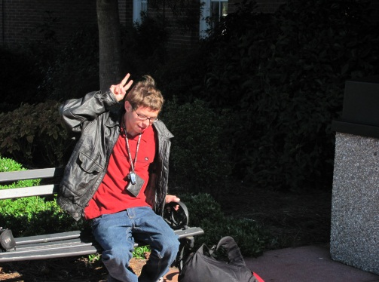
The CCU college experience…

Slide 23
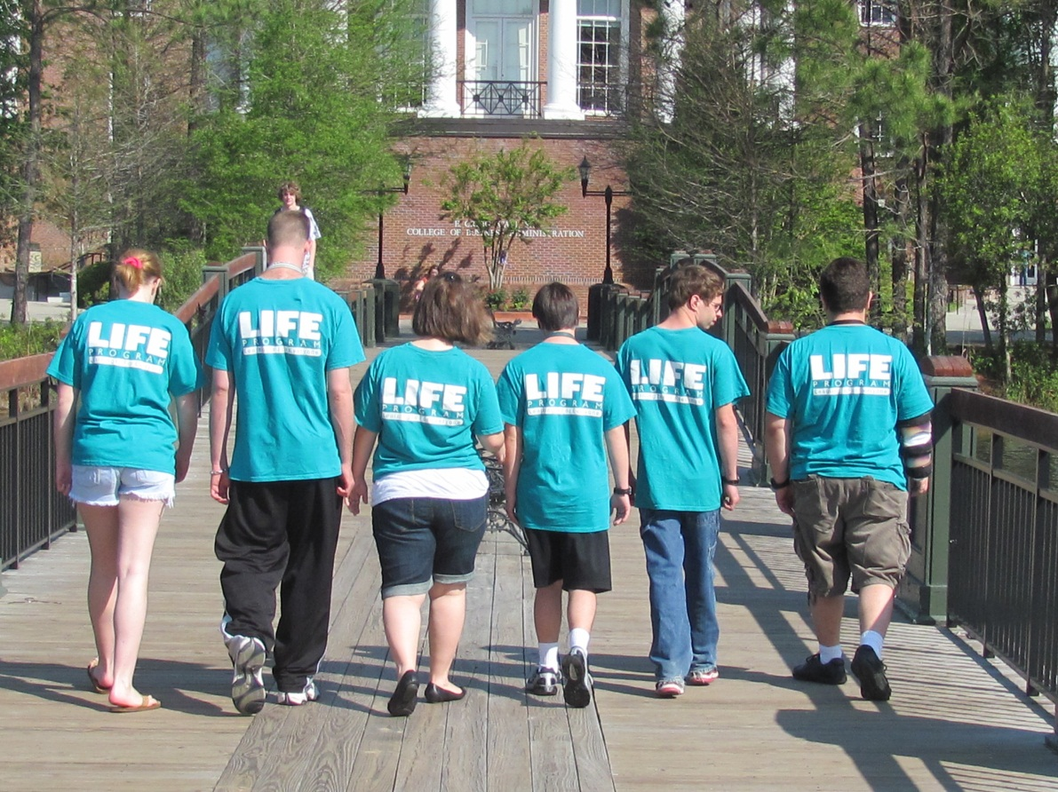
…priceless.

Slide 24
Questions? Contact us…
Zan Wiggins Director Biddle Center for Teaching, Learning, & Community Engagement
843-349-2665
zwiggins@coastal.edu
Sandra Saunders
LIFETM Program Coordinator Biddle Center for Teaching, Learning, & Community Engagement
843-349-2387
ssaunders@coastal.edu

