Slide 1
Cooperating Teacher of Interns Orientation

Slide 2
Cooperating Teachers serve an important role in Teacher REtention
According to CERRA’s Supply and Demand Report for 2022-2023, there has been a 39% increase in teacher vacancies. 1 in 7 teachers left the profession at the end of 2022 and 36% of those who left teaching were in the first 5 years of their careers.
Research and experience tell us that novice teachers benefit from mentor support early in their careers (this includes during internships and practicums).
If we want teachers to remain in the profession, pre-service teacher success is critical.

Slide 3
Ccu Has two kinds of cooperating teachers – Practicum and Internship
Cooperating Teachers who host practicum students typically have a student visit several times during the semester. This can be for one day a week or multiple days. Placement length varies based on program scheduling. The number of required hours varies from 30 – 250.
Practicum Cooperating Teachers observe lessons and provide critical feedback to students in these early experiences.
Practicum Cooperating Teacher Qualifications
1 year of successful teaching experience
Completion of Cooperating Teacher Training
Certification in the subject area or grade level
Positive recommendation by principal

Slide 4
Cooperating Teachers of Interns
Cooperating Teachers who host interns have a student full time in their classrooms for 15 weeks. The student must teach the full load of the classroom for 35 consecutive days. The state department requires a minimum of 60 days of internship.
CCU has always required MORE than the minimum. These students follow the exact schedule of the teacher and stay the entire day and beyond for planning and duty. Cooperating Teachers of interns do observe and evaluate the student as well as provide daily feedback.
Intern Cooperating Teacher Qualifications
3 years of successful teaching experience
Completion of state mentor training, ADEPT Training, and Cooperating Teacher Training
Certification in the subject area or grade level
Positive recommendation by principal

Slide 5
Compensation
At the end of the semester, Coastal Carolina University provides cooperating teachers of partnering schools who host a CCU intern a certificate for one graduate course (value of current graduate tuition), or 20 licensure renewal credits. This allows CCU to continue providing partners with appreciation certificates and maintain the economic viability of the CCU graduate programs.
Cooperating teachers who host 2 practicum students in a 2 year period may also earn a certificate.

Slide 6
Additional information about certificates
The certificate does expire and should be utilized within a two-year period. It will be issued via email in a PDF and will not be reissued if lost. Extensions beyond this two-year period will not be offered.
This certificate will not be issued to any cooperating teacher who has not completed his/her information sheet, uploaded a current teaching certificate, or verification of required trainings.
These certificates can not be used for any PhD courses or contract courses.

Slide 7
What are some needs of a preservice Teacher?
Social/Emotional | Physical | Instructional
Need to feel valued Relational connections Sense of efficacy Frequent constructive feedback (both oral and written) | Culture – professional learning communities, institutional and school level support School/district structure and policies Location of resources (people and materials) Understanding Professionalism – school norms, appropriate dress, punctuality, use of cell phones and social media | Lesson planning Content Knowledge Assessment Strategies Questioning Techniques Personal Reflection Classroom Management Interactions with Parents/Students
Just like your own students, preservice teachers must have Social and Emotional needs met before they can ever begin working on their instructional needs.

Slide 8
How do Cooperating Teachers Meet these important needs?
Social/Emotional | Physical | Instructional
Trusted listener/Confidant Advocate Resource Motivator Cheerleader | Resource Facilitator Tour guide Planner/Organizer | Sounding board Model/Demonstrator Facilitator Observer (not evaluator in the beginning) Collaborator Consultant Coach (instructional, data) Diagnostician Role model Reflective guide

Slide 9
Assessments/Expectations during The internship semester

Slide 10
The Nitty-Gritty of What is Expected…
4 Formal Observations using the Intern Observation and Post Conference Form.
3 Formal Conferences (Preliminary, Formative and Summative)
2 Internship Evaluations by Content Area (Formative and Summative)
2 Expanded ADEPT Rubric Evaluations (Formative and Summative)
Assessment of Teacher Candidate Dispositions (Discussions at Preliminary and Formative, Evaluation completed at Summative )
2 Conceptual Framework Assessments (formative and summative)

Slide 11
What is Expanded ADEPT?

Slide 12
Expanded ADEPT
South Carolina Teaching Standards 4.0 rubric selected to replace SAFE-T as a part of Expanded ADEPT
Initiative led by SCDOE and educators from across the state
Supports educators with feedback related to professional practice, is not simply based on student test scores
New rubric is aligned to the Profile of the South Carolina Graduate
Instruction
Environment
Planning
Professionalism
Notes:
A new rubric was selected as part of the Expanded ADEPT Support and Evaluation System. The initiative was led by the South Carolina Department of Education and an advisory group made up of educators across the state.
The new South Carolina Teaching Standards 4.0 rubric will better support educators with specific feedback related to professional practice.
This tool is designed to assess a teacher’s professional practice and hosts four domains: Instruction, Environment, Planning and Professionalism – each with indicators and specific descriptors that differentiate levels of performance.
The new rubric is aligned to the Profile of the South Carolina Graduate. It is research-based to lead to instruction that raises performance. And, it supports districts in effective instructional leadership — making it easier to focus on professional development with common language and practices for observation.
The rubric was identified by a working group of South Carolina educators as a tool that is validated, supportive of educator professional growth and development and aligned with instructional practices that will enable students to meet the standards for college and career readiness in the Profile of the South Carolina Graduate.
The ADEPT system is designed as a tool to assess instruction as well as improve it. Our goal is to provide students in South Carolina with a high quality education led by effective educators. Evaluations are a mechanism to help us accomplish that.

Slide 13
South Carolina Teaching Standards
Planning
Environment
Instruction
Professionalism
Instructional Plans
Student Work
Assessment
Managing Student Behavior
Expectations
Environment
Respectful Culture
Standards & Objectives
Motivating Students
Presenting Instructional Content
Lesson Structure & Pacing
Activities & Materials
Questioning
Academic Feedback
Grouping Students
Teacher Content Knowledge
Teacher Knowledge of Students
Thinking
Problem Solving
Growing and Developing Professionally
Reflecting on Teaching
Community Involvement
School Responsibilities

Slide 14
The Benefits of Expanded ADEPT
Holistic approach
Frequent, robust and objective feedback
Connection between teacher practice and student learning
RESULTS: Students are college and career ready
Notes:
One of the advantages of the new system is its holistic approach. It allows us to provide more frequent, robust and objective feedback to teachers and administrators that incorporates multiple indicators of success — not simply student test results.
This approach gives educators the guidance they need to be more effective while also promoting professional growth and development.
A major focus is a more direct connection between teacher practices and increased student learning through the incorporation of student academic growth measures into classroom-based teacher evaluation and effectiveness ratings.
This evaluation system was created with the end in mind by having teachers who are more effective educators and students who are college and career ready.

Slide 15
Parts of the Rubric
Domains
Indicators
*Descriptors
*Performance Levels
Instruction
 | Exemplary (4) | Proficient (3) | Needs Improvement(2) | Unsatisfactory (1)
Standards and Objectives | All learning objectives and state content standards are explicitly communicated. Sub-objectives are aligned and logically sequenced to the lesson’s major objective. Learning objectives are: (a) consistently connected to what students have previously learned, (b) know from life experiences, and (c) integrated with other disciplines. | Most learning objectives and state content standards are communicated. Sub-objectives are mostly aligned to the lesson’s major objective. Learning objectives are connected to what students have previously learned. | Some learning objectives and state content standards are communicated. Sub-objectives are sometimes aligned to the lesson’s major objective. Learning objectives are not clearly connected to what students have previously learned. | Learning objectives and state content standards are not communicated. Sub-objectives are rarely aligned to the lesson’s major objective. Learning objectives are rarely connected to what students have previously learned. Expectations for student performance are vague. State standards are not appropriately displayed. There is evidence that few students demonstrate mastery of the objective.
Notes:
These slides will highlight each element of the rubric (Domain, Indicator, Descriptors and Performance Levels) in slide show mode. TG

Slide 16
Instruction
Student Centered Teacher Centered
 | Exemplary | Proficient | Needs Improvement | Unsatisfactory
Description of Qualifying Measures | Consistent Evidence of Student Centered Learning/Student Ownership of Learning- Teacher Facilitates the Learning. | Some Evidence of Student Centered Learning/ Student Ownership of Learning – Teacher Facilitates the Learning | Moving Towards Student Centered Learning/Student Ownership of Learning- Consistent Reliance on Teacher Direction. | Heavy emphasis on Teacher Direction – Minimal Evidence of Student Ownership of Learning

Slide 17
South Carolina Teaching Standards 4.0 Self-Paced Teacher Training
All cooperating teachers of Coastal Carolina University Interns must complete the self-paced one day teacher training. You can complete this online at your own pace. This training is found on the CCU Website: https://www.coastal.edu/scoess/studentsupportandengagement/internshipinformation/cooperatingteachers/

Slide 18
Expanded ADEPT Training Module for Cooperating Teachers
All cooperating teachers of Coastal Carolina University Interns must view the Training Module for Cooperating Teacher on the Expanded ADEPT Support and Evaluation System. You can complete this online at your own pace. This training is found on the CCU Website: https://www.coastal.edu/scoess/studentsupportandengagement/internshipinformation/cooperatingteachers/

Slide 19
SCTS 4.0 Rubric (beige form)
Cooperating teachers will complete this rubric assessment prior to the formative and summative conferences.
This is the same tool being used for the evaluation of induction teachers in many districts this year.

Slide 20
Assessment of Teacher Candidate Dispositions
What are dispositions? Dispositions are the commitments, values and professional ethics that influence candidate behaviors towards students, families, colleagues and communities. The dispositions are the driving forces that affect candidate learning, motivation and development toward continual professional growth.
Disposition assessment is ongoing. Interns are formally assessed at the summative conference (hot pink form). Any concerns about an intern’s disposition should be addressed immediately to the intern and university supervisor.

Slide 21
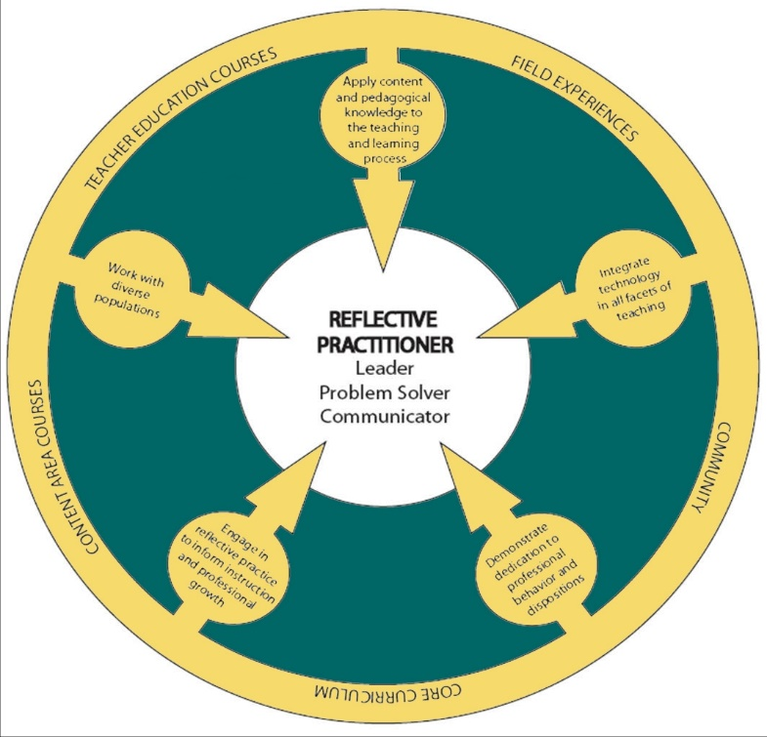
Conceptual Framework and internship evaluation

Slide 22
Conceptual Framework The Teacher as Reflective Practitioner
The Framework has five essential elements called candidate proficiencies.

Slide 23
Element 1
An ability to apply content and pedagogical knowledge to teaching and learning process.
(Candidates must know what to teach and how to teach it.)

Slide 24
Element 2
An ability to integrate technology in all facets of teaching.
(Candidates must use technology to plan, deliver, and assess instruction.)

Slide 25
Element 3
An ability to work with diverse populations.
(Candidates must be effective when working with diverse professional, student, and community populations.)

Slide 26
Element 4
An ability to demonstrate dedication to ethical professional behavior and dispositions.
(Candidates must model and reinforce ethical behavior in all professional activities.)

Slide 27
Element 5
An ability to engage in reflective practice to inform instruction and professional growth.
(Candidates need to become students of the teaching profession which is characterized by reading and learning about best practices in order to self-assess their own professional practices to improve teaching and student learning.)

Slide 28
Internship Evaluations (lilac form)
You will complete 2 internship evaluations based on the conceptual framework. These assessments are completed at the formative and summative conferences.
These evaluations also include program specific assessments as well.

Slide 29
Prior to the Start of Internship
Attend SC Mentor Training
Complete the Cooperating Teacher Information Sheet online at
https://www.coastal.edu/forms/education/studentservices/cooperatingteachers/
Upload a copy of your current SC Teaching Certificate
Respond to any emails your intern sends you
Complete a cooperating teacher orientation
View the online trainings for the SCTS 4.0 Rubric and the SC Expanded ADEPT as it applies to internship.

Slide 30
During the first few days
See pages 22 – 24 of the Cooperating Teacher Handbook for suggestions for the first few days of internship.

Slide 31
Preliminary conference
This conference occurs within the first 10 days of internship and typically lasts 30 minutes.
Be familiar with the agenda for this conference and have any requested materials/forms ready.

Slide 32
First Four WEeks
Create a schedule that includes when the intern will begin teaching each class/subject, when they will complete their unit work sample, and when they will begin full-time teaching (mandatory 35 days).
Provide opportunities for Co-Teaching
Review all lesson plans
Gradually release classroom responsibilities
Provide continuous formative feedback orally and in writing
Complete observation #1 using the CCU Internship Observation Form

Slide 33
Weeks 4-8
Provide opportunities for co-teaching
Review all lesson plans
Provide continuous formative feedback orally and in writing
Gradually release teaching responsibilities and course/subject loads
Complete observation #2

Slide 34
Formative Conference
This conference occurs at the midpoint of the internship. It includes the intern, the cooperating teacher, and the university supervisor. This conference typically takes at least 30 minutes. Be sure to familiarize yourself with the conference agenda and have the following items completed prior to the conference:
Be prepared to discuss the intern’s dispositions
Completed Internship Evaluation
Completed SC Teaching Standards 4.0 Rubric
Two completed intern observations and lesson plans

Slide 35
Weeks 9-10
Review all lesson plans
Intern should continue full-time teaching
Complete observation #3

Slide 36
Weeks 11-15
Review all lesson plans
After 35 days of full-time teaching, gradually release teaching responsibilities back to the cooperating teacher. We recommend the intern return the load of one subject area/course a week back to the cooperating teacher.
Complete observation #4
Secure observations for the intern in other classrooms in the school building. These observations can be for one class period or the whole day.

Slide 37
Summative conference
This conference occurs at the conclusion of the internship and includes the intern, cooperating teacher, and university supervisor. It typically takes at least 30 minutes. It is helpful to be familiar with the conference agenda and complete the requested items prior to the conference. The cooperating teacher needs to complete the following items:
Assessment of Teacher Candidate Dispositions
Internship Evaluation
SC Teaching Standards Rubric
Ensure the intern’s attendance in Anthology has been verified and is up to date
Two completed intern observations and lesson plans

Slide 38
Post Internship
After the internship is finished, complete the exit surveys to evaluate and assess the university supervisor and the internship experience.

Slide 39
What is co-teaching?
Co-teaching is when two or more educators share instructional responsibility and accountability for a single group of students. Co-teaching usually involves multiple activities occurring in one place. Co-taught classes tend to be highly interactive places with high levels of student engagement. Co-teachers need to be sure to outline roles and responsibilities so that BOTH educators have meaningful roles.

Slide 40
Station Teaching
Co-teachers divide content and students. Each teacher then teaches the content to one group and subsequently repeats the instruction for the other group.

Slide 41
Parallel teaching
The co-teachers are both teaching the same information, but they do so to a divided class group. The teachers teach the exact same lesson in the exact same way and use the same materials. The purpose is to increase active student engagement by lowering student-teacher ratios.

Slide 42
Alternative teaching/differentiated teaching
The co-teachers are both teaching the same information, but they do so in a divided class group. The teachers use different approaches to presenting the content. The purpose is to increase student engagement with a lower student-teacher ratio and to address the needs of all learners using a varied instruction approach.

Slide 43
Team Teaching
Both teachers know and can deliver the material of the lesson, “one script, two voices.” Therefore, both teachers share delivery of the same instruction to a whole student group.

Slide 44
Supplemental teaching
One teacher takes responsibility for the large group while the other works with a smaller group or individual student. Supplemental teaching can be used for remediation, acceleration, pre-teaching, helping students who have been absent, giving assessments, etc.)

Slide 45
One Teach-One Observe
Co-teachers decide in advance what types of specific observational information to gather during instruction and agree on a system of gathering the data. This is referred to as “observing with a focus.”

Slide 46
One Teach-OnE assist
One teacher has the primary responsibility for teaching while the other teacher circulates through the room providing unobtrusive assistance to students, as needed.

Slide 47
Other helpful information

Slide 48
Attendance Expectations
Attendance is expected on all internship days.
The university supervisor is the only individual who can approve excused absences.
The intern should notify the cooperating teacher in advance of an absence.
All unexcused absences will require additional days in internship.

Slide 49
Communication protocol
The professional chain of command protocol applies to all communication related to field experiences. Interns, cooperating teachers and University supervisors should communicate issues of concern or problems immediately to the appropriate person.
Interns should direct questions and concerns to the cooperating teacher and/or university supervisor.
Cooperating teachers should address questions to the University supervisor.
Cooperating teachers should address concerns to the University supervisor after discussing the issue with the intern.

Slide 50
How does an intern benefit you and your students?
Lowers the pupil-teacher ratio
Provides opportunities for co-teaching
Presents opportunity for professional growth
Forces personal reflection
Typically positively effects student outcomes/growth
Allows time for more frequent one on one interactions with students
Professional partner

Slide 51
If you have questions, please contact Betsey Costner
btcostne@coastal.edu

