Slide 1
Expanded ADEPT Support and Evaluation System
Training Module for Cooperating Teachers and Supervising Faculty
1

Slide 2
Note to Participants
This ADEPT seminar is intended to provide cooperating teachers and supervising faculty with the knowledge and skills to assist and assess teacher candidates relative to the Expanded ADEPT System requirements
This seminar will NOT qualify participants to serve as ADEPT evaluators of practicing teachers.

Slide 3
Purpose of the Expanded ADEPT System
To continuously develop educators at all performance levels through an evaluation system that:
is valid, reliable, and fair and
produces actionable and constructive feedback that supports professional growth
To re-focus our attention on intended student outcomes, allowing educators to align and strengthen professional practice to support those intended student outcomes

Slide 4
The Expanded ADEPT System Requirements
Apply to all districts in the state
Apply to all SC teacher preparation programs, and
Apply throughout every stage of a teacher’s career

Slide 5
The Expanded ADEPT System Requirements apply to the following educators:
Traditionally Prepared Teachers
Alternatively Prepared Teachers (PACE, ABCTE, Teach for America)
International Teachers
National Board Certified Teachers
Career and Technology (CATE) Teachers
Teachers employed from out-of-state
Working Retired Teachers
Notes:
Working retired teachers – an example would be….?

Slide 6
Expanded ADEPT for
Teacher Candidates
Student teaching is the capstone Expanded ADEPT experience for teacher candidates
Teacher candidates must be assisted and evaluated relative to all Expanded ADEPT Performance Standards
Teacher Candidates must receive formative assistance and summative evaluations from both IHE and P-12 faculty

Slide 7
Dual Roles for Supervising Faculty During Student Teaching
Facilitator (Coach)
Evaluator
(Gate Keeper)
Provide Coaching and Support
Make Judgments
Provide Formative Feedback
Analyze and Critique Performance
Explain and Guide
Document and Evidence
Demonstrate/Co-teach
Summative
Formative

Slide 8
System Functions
The Expanded ADEPT System has three functions:
Assisting
Developing
Evaluating

Slide 9
Expanded ADEPT Processes
The system has five processes:
Preservice
Induction
Formal (Summative) Evaluation
Diagnostic Assistance
Informal (Formative) Evaluation: Goals-Based Evaluation (GBE)

Slide 10
Connecting Functions and Processes Each Expanded ADEPT process has a primary function
Assisting
Developing
Evaluating
Induction and Mentoring
Preservice
Formal (Summative) Evaluation
Diagnostic Assistance
Goals-Based Evaluation (GBE)

Slide 11
Expanded ADEPT Processes are:
Informal (Formative)
Formal (Summative)
Results are used to assist teachers and to develop and enhance teaching performance
Preservice
Induction
Diagnostic Assistance
Goals-Based Evaluation
Results are highly consequential and are used to make decisions about contracts and certificate advancement or sanctions
Formal (Summative) Evaluation

Slide 12
Formative Evaluation
Summative Evaluation
E
V
A
L
U
A
T
I
N
G
D
E
V
E
L
O
P
I
N
G
A
S
S
I
S
T
I
N
G
Assessment FOR Learning
Assessment OF Learning
Goal = Improvement
Goal = Judgment
Low-Stakes, Ongoing
High Stakes, Less Frequent

Slide 13
Expanded ADEPT Formal (Summative) Evaluation results are used:
at the state level for certificate advancement purposes
at the district level to make contract and employment decisions
at the state level to determine when sanctions should be taken against a teacher’s certificate
at the higher education level to make decisions regarding a teacher candidate’s recommendation for initial certification
at the higher education level as a part of each institution’s report card

Slide 14
Teacher Candidate Evaluation during Student Teaching
During the student teaching semester, each teacher candidate is provided with feedback in order to enhance his or her professional knowledge and skills.
At the conclusion of student teaching, each teacher candidate receives a judgment regarding his or her overall performance relative to the ADEPT Performance Standards.
Formative
Summative

Slide 15
Expanded ADEPT and Career Development
What do our teacher candidates need to know about ADEPT throughout their teaching careers?

Slide 16
Certificate
The teaching certificate is an educator’s “license” to teach. Certificates are issued by the South Carolina Department of Education, and they are valid in all school districts in South Carolina.
Two certificate levels:
Initial
Professional

Slide 17
Contract
A contract is an employment agreement with the local school district.
Three contract levels
Induction
Annual
Continuing

Slide 18
 | Teaching Certificate (Teaching “license” from the state) | Contract Level (Employment agreement from the school district) | ADEPT Process
Beginning: Year 1 Length: 1 year to 3 years | Initial | Induction | Induction and Mentoring (Goal: To provide beginning teachers with support and assistance to facilitate their successful transition into the profession.)
Beginning: Year 2 Length: 1 to 4 years | Initial | Annual | Formal Evaluation (Goal: To provide teacher quality assurance to our stakeholders—the students, their parents, and our taxpayers.) or Diagnostic Assistance (Goal: To provide additional support and assistance to teachers in their second or third year of employment.) or Goals-based Evaluation (Goal: To support teachers’ ongoing professional development.)
Beginning: Upon successful completion of the formal evaluation and obtaining a professional certificate Length: Duration of career | Professional | Continuing | Goals-Based Evaluation (Goal: To support teachers’ ongoing professional development.) or Formal Evaluation (Goal: To provide teacher quality assurance to our stakeholders—the students, their parents, and our taxpayers.)
Notes:
Check information for accuracy.

Slide 19
PERFORMANCE STANDARDS
Expanded ADEPT Training

Slide 20
The Importance of Professional Standards
Articulated standards or expectations for competent practice are the defining attributes of any profession.

Slide 21
Overall Structure of Expanded ADEPT
Five major concepts
Domains
ADEPT Performance Standards (APSs)
Key Elements
Data
Formative and Summative Assessments

Slide 22
What are domains?
Domains are broad categories of professional knowledge. They function as organizers for the ADEPT Performance Standards and for the data collected during the evaluation process. The domains facilitate informed decision making.
Four Domains
I. Planning
II. Instruction
III. Environment
IV. Professionalism

Slide 23
What are performance standards?
Statements of what teachers
should know,
be able to do,
and assume responsibility for
on an ongoing basis –
throughout all phases of their careers.

Slide 24
What are Key Elements?
In simplest terms, the key elements give meaning to the performance standards by identifying their most important components.

Slide 25
What is the relationship between performance standards and key elements?
Within each performance standard, each key element statement is followed by a key paragraph that defines and describes the key element.
The definitions and descriptions are intended to explain the key elements. They are not intended to be all-inclusive or to be used as presence/absence checklists.

Slide 26
What is meant by data?
Data refer to information that is collected during the ADEPT process that is relatively free from a judgment of value or worth of the teacher based on the information.

Slide 27
Within Expanded ADEPT, six types of evidence (data) are collected:
The long-range plan (APS 1)
The unit work sample (APSs 2 and 3)
The classroom observation records (APSs 4-9)
The teacher’s reflections on instruction and learning (APSs 4-9)
The professional review (APS 10)
The professional self-assessment and professional growth and development plan (APS 10)

Slide 28
Dossier
During the ADEPT formal evaluation process, all data are placed in a dossier that is maintained by the chair of the evaluation team.
All evaluators have access to the teacher candidate’s dossier.
The evaluators analyze the data in the dossier to arrive at their evaluation judgments

Slide 29
What is meant by formative assessment?
Formative assessment refers to the process of analyzing data and using the information to inform and improve practice.
Formative assessment is an ongoing process that occurs at every level of the ADEPT System (preservice, induction, formal evaluation, diagnostic assistance, GBE).

Slide 30
What is meant by summative assessment?
Summative assessment refers to the process of analyzing data and using the results to make high-stakes, consequential decisions (i.e., successful completion of directed teaching).
Summative assessment occurs most often at the preservice and evaluation levels of the ADEPT System.

Slide 31
AT COASTAL CAROLINA UNIVERSITY
Expanded ADEPT

Slide 32
Performance Evaluation & ADEPT
Evaluations of interns is an important component of the teacher education program and is a rigorous multi-dimensional process.
To evaluate the professional performance portion of the internship, the South Carolina Teaching Standards 4.0 Rubric is used.

Slide 33
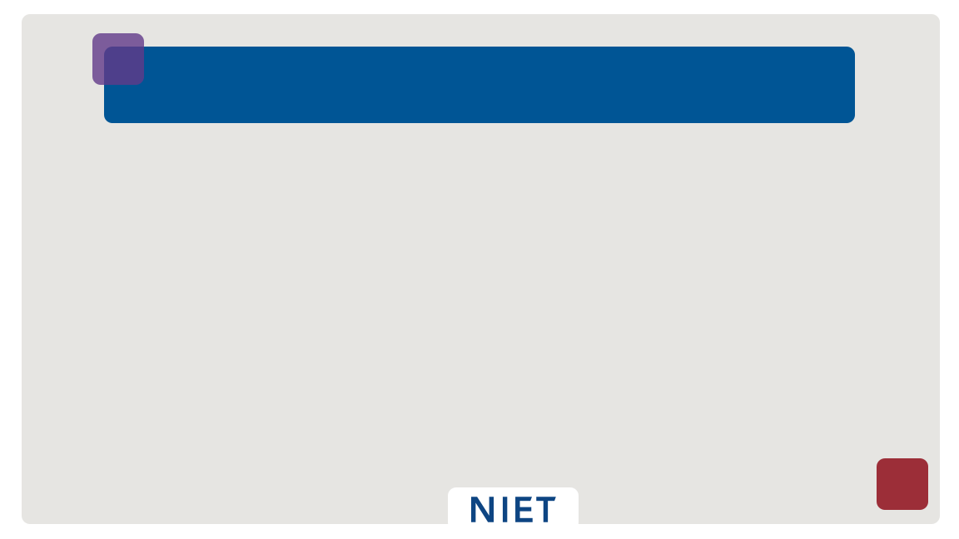
South Carolina Teaching Standards
Instruction Domain
Planning Domain
Environment
Domain
Standards & Objectives
Motivating Students
Presenting Instructional Content
Lesson Structure & Pacing
Activities & Materials
Questioning
Academic Feedback
Grouping Students
Teacher Content Knowledge
Teacher Knowledge of Students
Thinking
Problem Solving
Instructional Plans
Student Work
Assessment
Managing Student Behavior
Expectations
Environment
Respectful Culture
Professionalism
Domain
Staff Development
Instructional Supervision
School Responsibilities
Reflecting on Teaching

Slide 34
Parts of the Rubric
Domains
Indicators
Descriptors
Performance Levels
Instruction
 | Exemplary (4) | Proficient (3) | Needs Improvement(2) | Unsatisfactory (1)
Standards and Objectives | All learning objectives and state content standards are explicitly communicated. Sub-objectives are aligned and logically sequenced to the lesson’s major objective. Learning objectives are: (a) consistently connected to what students have previously learned, (b) know from life experiences, and (c) integrated with other disciplines. | Most learning objectives and state content standards are communicated. Sub-objectives are mostly aligned to the lesson’s major objective. Learning objectives are connected to what students have previously learned. | Some learning objectives and state content standards are communicated. Sub-objectives are sometimes aligned to the lesson’s major objective. Learning objectives are not clearly connected to what students have previously learned. | Learning objectives and state content standards are not communicated. Sub-objectives are rarely aligned to the lesson’s major objective. Learning objectives are rarely connected to what students have previously learned. Expectations for student performance are vague. State standards are not appropriately displayed. There is evidence that few students demonstrate mastery of the objective.

Slide 35
Interns receive both formative and summative feedback throughout the semester. Formative and Summative assessments are used by cooperating teachers and university supervisors to evaluate progress towards competencies.
Formative Assessment
Not for grades
Monitor progress
Provide specific written and oral feedback
Give candidates opportunities to close the gap between where they are and the competencies to be mastered.
Summative Assessment
Provide information for grades
Evaluate what candidates know and can do
Make judgements about mastery of competencies

Slide 36
Observations
Observations and feedback to candidates documenting the South Carolina Teaching Standards 4.0 Rubric/Expanded ADEPT are the primary means for evaluating and promoting continuing improvement of the candidate’s teaching performance.
Within a collaborative partnership, the cooperating teacher and university supervisor work as a team to provide observational feedback to candidates.
Observations should occur using the CCU Internship Observation Form and should last approximately 30 – 60 minutes.
Both oral and written feedback on observations should be provided to the intern within three business days.
Both the cooperating teacher and university supervisor will complete 2 observations before the formative conference and 2 observations before the summative conference.

Slide 37
Expectation for Successful Completion of the Internship
An intern has successfully completed the ADEPT process at Coastal Carolina University if they have an average score of “proficient” on the SCTS 4.0 Rubric at the summative evaluation.

