Slide 1
Finance Query
Self-Service
New User Training

Slide 2
01
Budget Accounts 10-Funds: Slides 3-12
Table of Contents
05
Finance Query Self-Service Log In: Slides 16-21
Finance Query Self-Service 10- Fund Account View: Slides 26-32
02
06
Finance Query Self-Service Non-10 Fund Account View: Slides 33-36
03
Non-10 Fund Accounts: Slides 13-15
07
Functions of Finance Query Self-Service: Slides 37-44
04
08
Helpful Information: Slides 45-50
Finance Query Self-Service First Time Setup: Slides 22-25
2

Slide 3
01
Finance Query Self-Service Log In
16

Slide 4
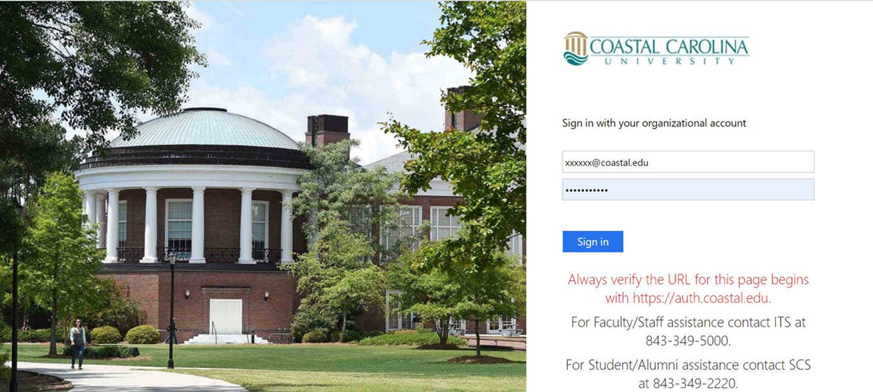
Self-Service Log In
Log into Self-Service using your single sign-on
Self-Service Link: https://sservice.coastal.edu/Student/ColleagueFinance
17

Slide 5
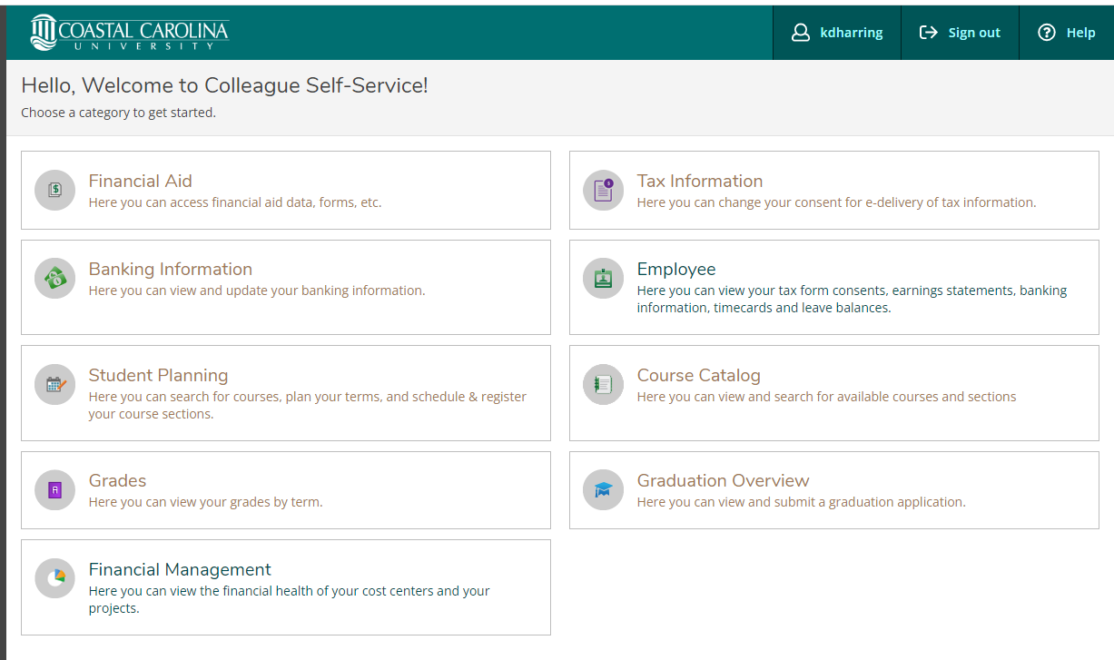
Self-Service Log In
Select “Financial Management” category from the Self-Service home page
18

Slide 6
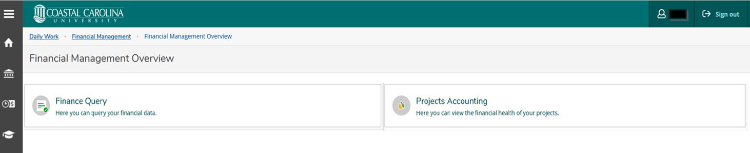
Self-Service Log In
Once you select the “Finance Management” category in Self-Service home page, you will see two options:
Finance Query
Project Accounting
You will select “Finance Query” to view your departmental accounts
You will select “Projects Accounting” to view your projects if applicable
19

Slide 7
MyCCU Tile
You can also use the “Finance and Administration” tile within the MyCCU page to log into Self-Service for Finance.
MyCCU is a new online personal dashboard providing a single entry point to access various CCU services and resources online.
You can access MyCCU at myccu.coastal.edu in any browser
To easily access training materials and other useful information for Finance Self-Service, please locate the “Finance and Administration” tile within the MyCCU page. The steps to locate and access the MyCCU tile will be on the next slide.
20

Slide 8
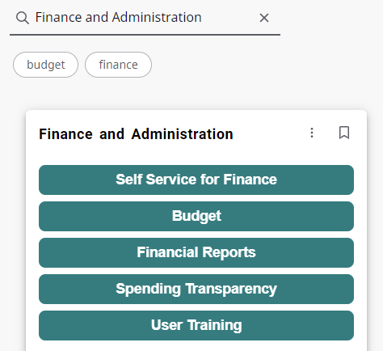
MyCCU Tile
Steps to locate and access Finance and Administration MyCCU Tile
1. Click on the Discover More button at the bottom of the MyCCU home screen
2. Type “Finance and Administration” into the search field at the top left
3. To bookmark/save a card, click on the bookmark icon in the upper right-hand corner of the card.
21

Slide 9
02
Budget Accounts: 10 Fund
3

Slide 10
10 Funds Budget Overview
10 Fund Accounts are the ONLY accounts that are budgeted
Budgets are determined based on projections of tuition, fees, and state funding each fiscal year
4

Slide 11
10 Funds Budget Overview
10 Fund Budget accounts are governed by the State Procurement Code and the Expenditure Policy (FAST-204)
The 10 Fund Budget is developed and approved annually. Budgets that have not been spent by the end of the current fiscal year, will not carry forward to the next fiscal year. New departmental budgets are available in Finance Query Self-Service on July 1st.
5

Slide 12
Account Number Structure
Fund:
10-xxxx-xxxx (Operational Funds)
Department :
10-6310-xxxx (Finance & Administration)
Expense Type or Object Code:
10-6310-5501 (Supplies)
6

Slide 13
Definitions of All Funds
Fund | Name | Type | Notes
10 | Operational Funds | E&G | Tuition & State Appropriations.
14 | Other Unrestricted Funds | E&G | Discretionary Money - Funded annually from the 29 fund.
15 | Designated Funds | E&G | Athletics, clubs and other student activities.
16 | Scholarships/Grant Match | E&G | Bookstore and bank scholarships - Funded annually from the 29
 |  |  | fund.
17 | Self-Generated Funds | E&G | Self-generated funds from sales and services provided by the
 |  |  | University from various departments.
18 | Extended Learning Funds | E&G | Self-generated funds for extended learning programs and study
 |  |  | abroad programs.
19 | Other Unrestricted Funds | E&G | Gifts from Coastal Education Foundation.
21 | Housing | Auxiliary | Housing Operations.
22 | Bookstore | Auxiliary | Bookstore Operations.
23 | Vending | Auxiliary | Vending Operations.
24 | Food Service | Auxiliary | Food Service Operations.
27 | Parking and Transportation | Auxiliary | New - Parking and Transportation Operations.
29 | Auxiliary Fund Holding | Auxiliary | Clear net revenues from operating auxiliaries for distribution to
 |  |  | other areas as needed.
31 | Federal Funds | Restricted/Grant | Pell, research and public service grants from Federal Govt.
32 | State Restricted Funds | Restricted/Grant | Lottery technology and scholarships from State Govt.
33 | County/Local Restricted Funds | Restricted/Grant | Horry County Higher Education, research grants from local govt.
34 | Commercial Restricted Funds | Restricted/Grant | Donations from business entities.
35 | Philanthropic Restr Funds | Restricted/Grant | Donations for research and public service purposes from others.
36 | Other Restricted Funds | Restricted/Grant | Other donations restricted by third party primarily for
 |  |  | scholarships.
60 | Endowments | Perm Restricted | One permanently restricted endowment from the state given years ago. All other endowments are held by the foundation.
71 | General Unexpended Plant | Plant Fund | Funds collected for debt service payment and for acquisition, building and major renovation purposes.
80 | Agency Funds | Agency | Student loans clear through these accounts.
90 | Pension Trust Funds | Pension (GASB68) | Net Pension Liability Expense and associated deferred outflows and inflows.
7

Slide 14
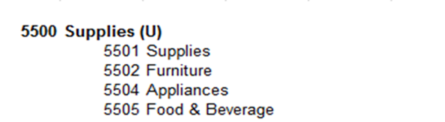
  “UMBRELLA” Accounts
  Umbrella accounts are a different set of object codes that are just for the 10 fund accounts. Budget is loaded into the umbrella account and expenses can not be charged to these accounts.
  The list below shows how umbrella accounts work for the 10 fund. One object code is used as the umbrella (5500) and the others are used for expenses that flow into that umbrella object code (5501,5502,5504,5505).
  You can find the entire listing of umbrella and object codes at: T: CCU/Chart of Accounts/Expense Object Codes
8

Slide 15
Budget Categories
The 10 fund accounts are broken into three different budget types: student staff, temporary staff and operating
  Temporary and Time-Limited Labor: (object codes: 5060 and 5081)
  Student Labor: (object codes: 5063 and 5051)
  Operating: (object codes: 5200-6300)
9

Slide 16
Budget Transfer Request
Budget transfer requests can be emailed to budget@coastal.edu. Email approval from budget officers on both accounts is needed before requesting a transfer.
Budget can only be transferred from one 10 fund to other 10 fund account. Budget can not transferred to other fund types.
Budgets can only be transferred within their own category type such as student labor, temporary labor, operating. This means that budget amounts can not be transferred from labor to operating and visa versa.
10

Slide 17
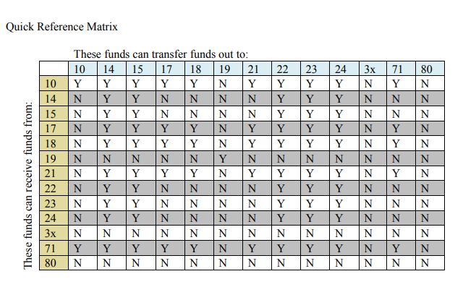
Expenditure Policy & Transfers
Policy Number: FAST-204
The purpose of this policy is to describe the various funds at Coastal Carolina University as well as the state regulations and University directives governing these funds. Expenses can be transferred between funds; provided that the expenditure is allowed by the receiving fund and is approved by the budget officer. Please see the Quick Reference Matrix shown below.
11

Slide 18
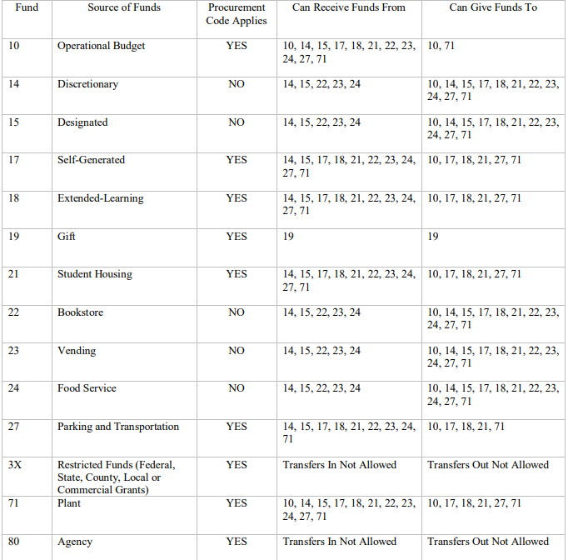
Expenditure Policy & Transfers
12

Slide 19
03
Non-10 Fund Accounts
13

Slide 20
Account Number Structure
Fund:
17-xxxx-xxxx (Self-Generated Funds)
Department :
17-6310-xxxx (Finance & Administration)
Expense Type or Object Code:
17-6310-5223 (Copier Lease)
14

Slide 21
Non-10 Fund Account Structure
Fund Balance (object code: 3999)
Revenues (object codes: 4XXX)
Expenses (object codes: 5XXX)
IIT’s/Chargebacks (object codes: 6XXX)
Transfers to/from other accounts (object codes: 8XXX-9XXX)
15

Slide 22
04
Finance Query Self-Service
First Time Setup
22

Slide 23
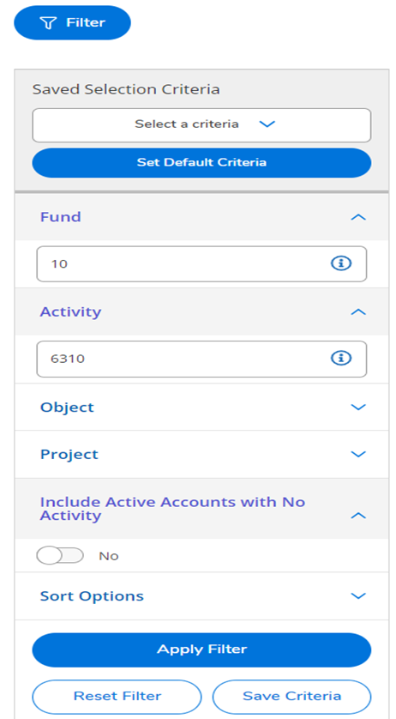
Self-Service First Time Set Up
1
Step 1: Once you select “Finance Query”, you will see the “Filter” icon. Click on the “Filter” button in the upper left corner of the Finance Query screen.
2
Step 2: Type in the Fund and Activity for one of your accounts. Leave the object and project fields blank
Step 3: Toggle from “Yes” to “No” under the Include Active Accounts with No Activity section
3
23

Slide 24
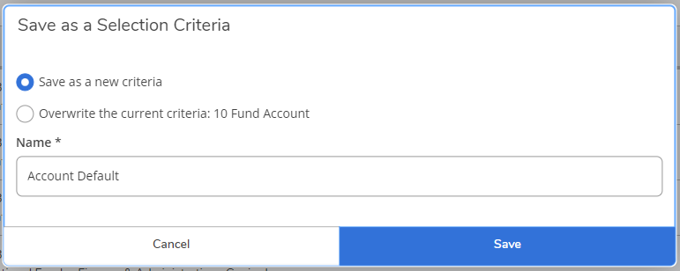
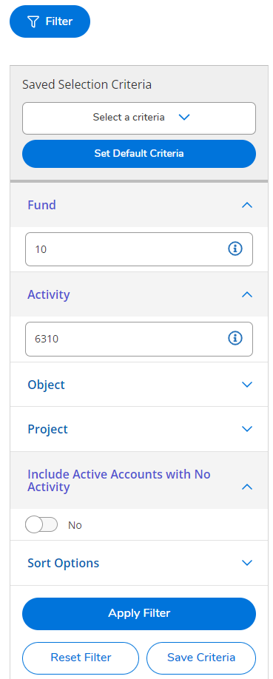
Self-Service First Time Set Up
4
Step 4: Click “Save Criteria”
Step 5: Enter a name of your selection for the default set up then click Save
5
Step 6: To set a default filter that will appear each time you access Finance Query, click on the “Set Default Criteria” button
6
24

Slide 25
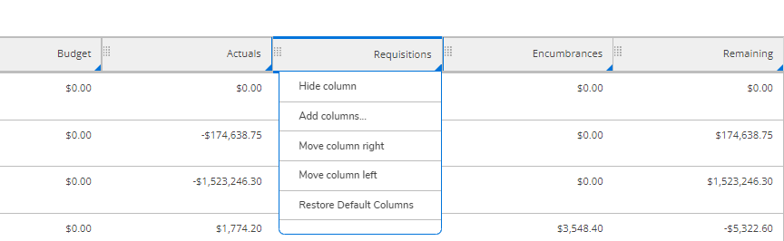
Self-Service First Time Set Up
Step 7: Left click on the Requisitions column and select “Hide Column”
7
25

Slide 26
05
Finance Query Self-Service
10 Fund Account View
26

Slide 27
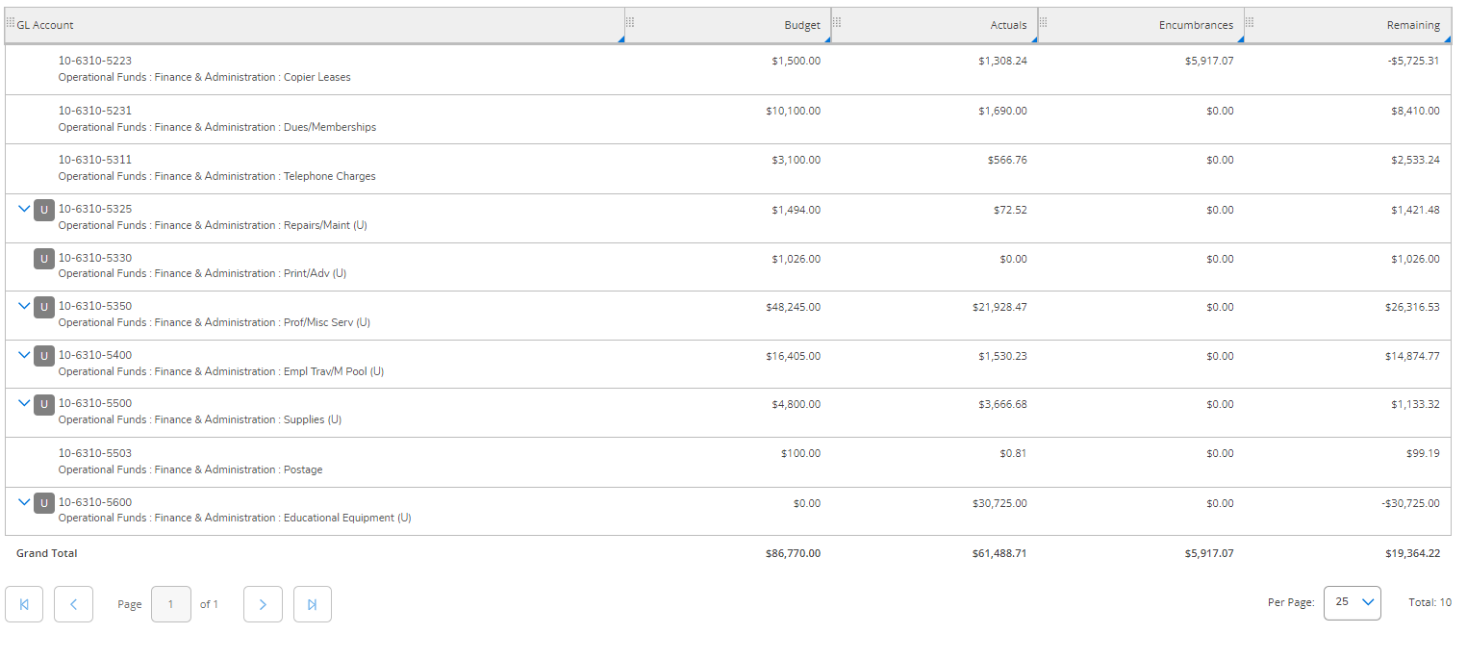
10 Fund View
This is how a 10 fund accounts will look in Finance Query in Self-Service
27

Slide 28
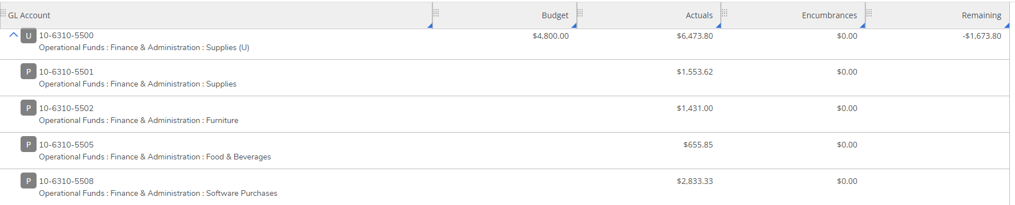
10 Fund Account
To view accounts/expenses that flow into umbrella object codes, you must click on the blue down arrow to expand the account
28

Slide 29
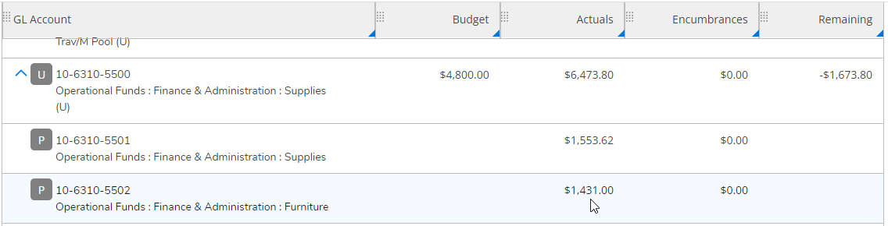
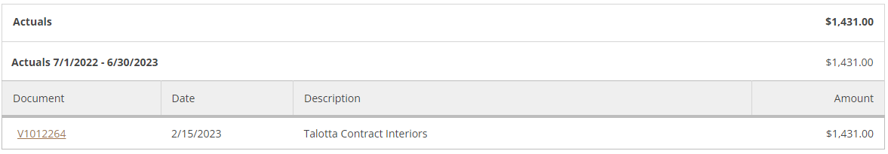
10 Fund Account: Drill into Actuals
To view detailed actual expenses, left click on the “actuals” amount to drill down into the actual line items
29

Slide 30
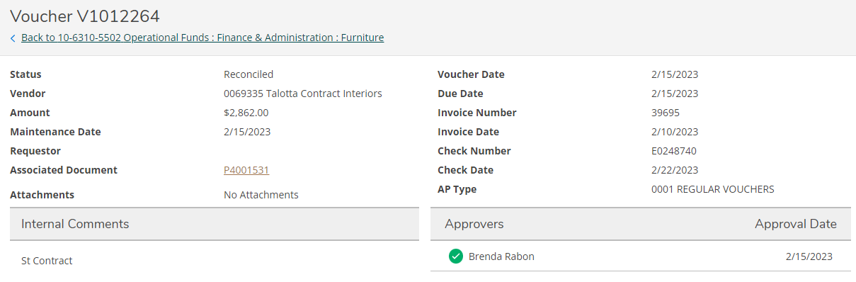
10 Fund Account: Transaction Detail View
To view details on specific actuals, left click on the “document” number to drill into the transaction detail view
30

Slide 31
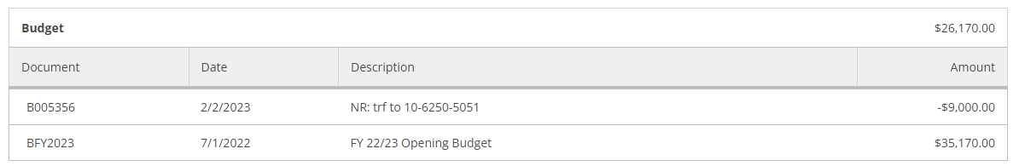
10 Fund Account: Drill into Budget
To view your opening budget and any budget adjustments, left click on the “budget” amount to drill down into the budget line items
Transfers labeled “NR” are non-recurring one-time budget adjustments that only affects the available budget in the current fiscal year
Transfers labeled “R” are recurring budget adjustments that affects the budget in the current and future fiscal years
31

Slide 32
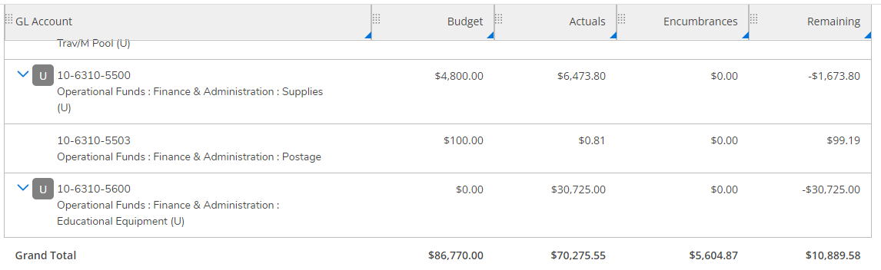
10 Fund Account: Budget Available Formula
Budget – Actuals – Encumbrances = Budget Remaining
32

Slide 33
06
Finance Query Self-Service
Non-10 Fund Account View
33

Slide 34
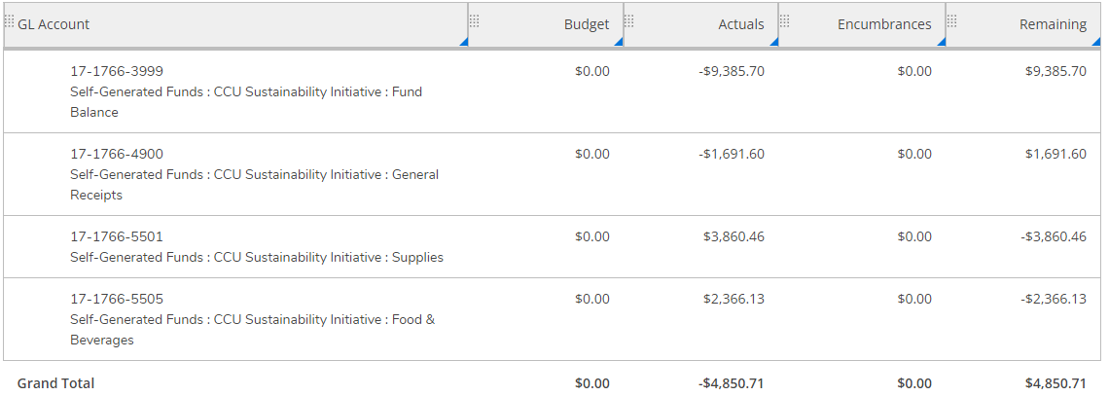
Non-10 Fund View
This is how a non-10 fund accounts will look in Finance Query Self-Service. These accounts differ from 10 fund accounts because they do not have allocated budget. These accounts receive available funds from deposited revenue.
34

Slide 35
Non- 10 Fund Account: Funds Available Formula
Actuals – Encumbrances = Funds Remaining
35

Slide 36
Non-10 Account: Actuals Formula
You can calculate your total non-10 fund actuals by using the formula listed below
Fund Balance (3999)
+ Revenues (4XXX)
– Expenses (5XXX-6XXX)
+ Transfers In (8XXX)
– Transfers Out (9XXX)
= Actuals Balance
36

Slide 37
07
Functions of Finance Query Self-Service
37

Slide 38
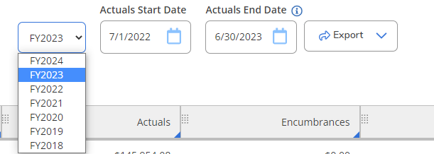
Functions of Self-Service
You can select different fiscal years from the drop down menu
38

Slide 39
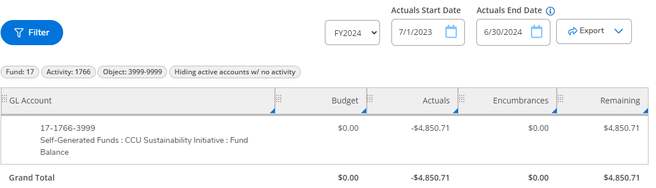
Estimated Carry Forward
Finance Self-Service provides access to estimated fund balances for the next fiscal year
39

Slide 40
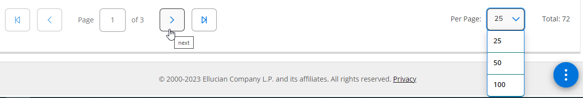
Multiple Pages & Per Page Options
Depending on the number of lines within your account, you may need to select the next page to completely view an account
Finance Self-Service defaults to 25 lines per page. You can increase the amount of lines shown to 50 or 100, depending on your preference.
40

Slide 41
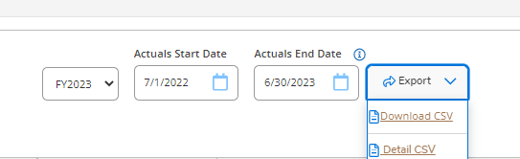
Functions of Self-Service
To view a summary version of our account in Excel: select the “Download CSV”
To view a detail version of our account in Excel: select the “Detail CSV”
41

Slide 42
Excel: “Download CSV” 10 Fund
Below is a sample of the “Download CSV” excel spreadsheet for a 10 fund account
42

Slide 43
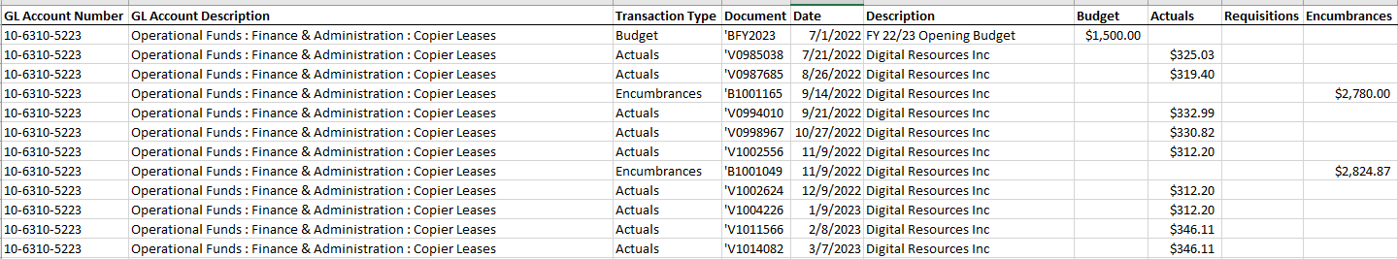
Excel: “Detail CSV” 10 Fund
Below is a sample of the “Detail CSV” excel spreadsheet for a 10 fund account
43

Slide 44
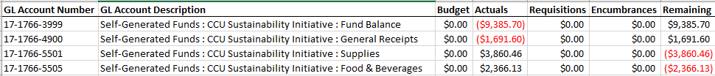
Excel: “Download CSV” Non-10 Fund
Below is a sample of the “Download CSV” excel spreadsheet for a non-10 fund account
44

Slide 45
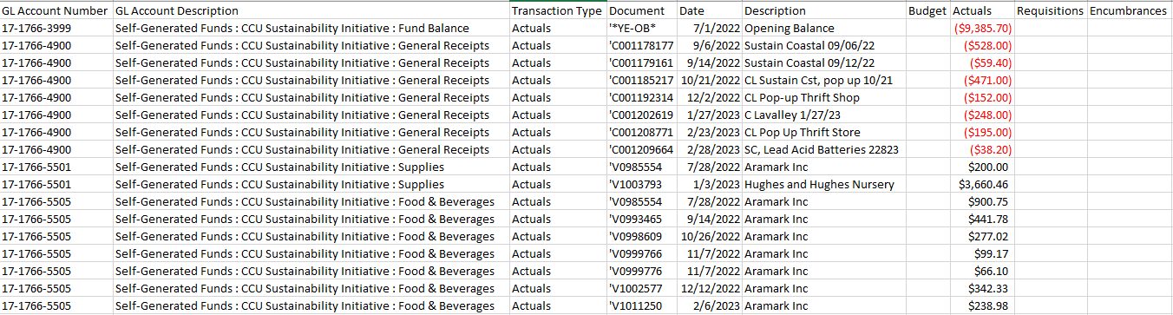
Excel: “Detail CSV” Non-10 Fund
Below is a sample of the “Detail CSV” excel spreadsheet for a non-10 fund account
45

Slide 46
08
Helpful Information
46

Slide 47
Budget Officer
  The person who is shown as the budget officer on the Chart of Accounts is the only person authorized to spend from the account. No other approvals will be accepted by Accounts Payable.
  To be added/removed as a budget officer, the current budget officer can send an email request to budget@coastal.edu.
  The current listing of budget officers can be found on the Chart of Accounts on the T:Drive at: T drive: CCU/chart of accounts/Chart of Accounts FY24
47

Slide 48
Finance Self-Service Request
  Budget officers can request for employees to be granted Finance Self-Service access. Finance Self-Service access will allow employees to view the requested accounts, but they will not have authority to approve expenses
  Finance Self-Service access allows budget officers to have additional help with managing their accounts.
  To request Finance Self-Service access, the current budget officer can send an email request to budget@coastal.edu.
48

Slide 49
ePro
Requesters in ePro, must have GL account access in order to place an order
Information related to ePro can be found on the ePro Website: https://www.coastal.edu/procurement/facultystaff/eproccu/
  Please contact Casey Keck, the ePro System Administrator, with any questions related to ePro at 843-349-2061 or ckeck@coastal.edu
49

Slide 50
Helpful Links
Self-Service
  https://sservice.coastal.edu/Student/ColleagueFinance
MyCCU
  myccu.coastal.edu
Chart of Accounts
  T drive: CCU/chart of accounts/Chart of Accounts FY24
Finance Self-Service Training Materials
  https://www.coastal.edu/financeadministration/selfserveforfinancetraining/
ePro
  https://www.coastal.edu/procurement/facultystaff/eproccu/
50

Slide 51
Contact Information
Melanie Brown, Budget Analyst
(843)-349-2262
mabrow14@coastal.edu
Olga Shabeka, AVP for Budget & Financial Planning
(843)-349-2611
vlshabek@coastal.edu
Or email budget@coastal.edu
51

