Slide 1
Fair Labor Standards Act (FLSA) Non-Exempt Employee Overview
Office of Human Resources & Equal Opportunity
October 2017
Notes:
Welcome to the Fair Labor Standards Act Training for Non-Exempt Employees. You have been assigned this training as a new hire or transitioning to a non-exempt status. Please pay close attention to this program as it will cover certain rights that you have as a non-exempt employee.

Slide 2
Disclaimer
This presentation is intended to provide general guidance regarding the Fair Labor Standards Act (FLSA) and its administration at Coastal Carolina University. This presentation is not considered to be a contract and is subject to change and/or interpretation as deemed necessary by Coastal Carolina University.
This is not intended as legal advice and is primarily for the purpose of general guidance.
Notes:
Disclaimer: This presentation is intended to provide general guidance regarding the Fair Labor Standards Act (FLSA) and its administration at Coastal Carolina University. This presentation is not considered to be a contract and is subject to change and/or interpretation as deemed necessary by Coastal Carolina University.
This is not intended as legal advice and is primarily for the purpose of general guidance.

Slide 3
What is the Fair Labor Standards Act?
Fair Labor Standard Act
Why is this information important to you?
Notes:
What is the Fair Labor Standards Act?
The Fair Labor Standards Act, commonly referred to as the “FLSA”, was enacted in 1938. The Act was introduced during the Great Depression in an effort to improve conditions for workers in the United States. The legislation established a forty-hour work week, created a national minimum wage, guaranteed “time-and-a-half” for overtime in certain jobs and mandated standards regarding employment of child labor.
At this point, you may be asking yourself, “Why do “I” need to know about the FLSA”? And, “How does it impact me”?
If you are attending this training, it has been determined that your position has been assigned a FLSA status of non-exempt. The purpose of this training is to provide you with information that you need to know to ensure that YOU are paid properly and in a timely manner.

Slide 4
Definitions
Non-Exempt: Covered by FLSA
Exempt: Not covered by FLSA
Notes:
The “FLSA” is considered to be an “employee protection act” whereby employees are generally presumed to be NOT EXEMPT from receiving overtime. The law does provide some exemptions.
What does the designation of “exempt” employee mean?
The Wage and Hour Division of the U.S. Department of Labor has outlined specific requirements that must be met in order to qualify for exemption. These requirements may be found at www.dol.gov. If an employee’s position is considered exempt, he/she is NOT eligible for overtime for hours worked over 40 in a specified work week.
What does the designation of “non-exempt” employee mean?
If a position does not meet the requirements for exemption under the duties test and/or the federal minimum salary threshold of $23,660 ($455 per week), the employee will be classified as non-exempt. If such a designation is made, the employee will become eligible for overtime earnings for all hours worked over 40 in a specified work week. For certain sworn law enforcement officers on a 14-day schedule, overtime eligibility is based hours worked over 80 in that particular work period. A non-exempt employee may be hourly or salaried.
How do I know what my exemption status is? If you have been hired into a position with an hourly rate, it has been determined that your position is non-exempt. If you are paid a salary, this information may be found in your offer letter or classification and compensation notice, it may be displayed on “My Benefits” page (on HREO Workplace) and/or identified on your position description. Your supervisor may also provide you with this information.
If you are unsure of your exemption status, you are encouraged to ask your supervisor or the Office of Human Resources and Equal Opportunity.

Slide 5
Minimum Wage Requirement
Effective July 24, 2009, the minimum wage was established at $7.25/hour.
Non-exempt employees must receive at least that rate per hour.
The new FLSA rules do NOT impact your current pay rate.
Notes:
The federal government has established a minimum wage for non-exempt employees in the United States. The current minimum is $7.25 per hour. Non-exempt employees must receive at least that rate per hour.

Slide 6
FLSA Does Not Require
Vacation, Holiday, Severance or Sick Pay
Meals or Rest Periods
Premium Pay for Weekend or Holiday Work
Pay Raises
Immediate Payment if Separated from Employment
Notes:
In the United States, employees often believe that their employers are required to offer certain benefits to their employees, such as Vacation, Holiday, Severance or Sick Pay, Meals or Rest Periods, Premium Pay for Weekend or Holiday Work, Pay Raises and Immediate Payment if Separated from Employment. Interestingly, the FLSA does not require employers nationally to offer any of these items.
At CCU, some of these items may be available, based on your employment status. The details won’t be covered during this presentation but may be provided by visiting HREO’s website, CCU’s policies page or by contacting HREO.

Slide 7
What is a Work Week?
A work week is 7 consecutive, 24 hour periods.
CCU’s work week begins at 12:01 am Sunday and ends at midnight the following Saturday.
Each work week stands by itself in determining overtime compensation for Non-Exempt employees.
Notes:
To better understand FLSA, it is important for you to understand some of the basics about CCU’s work week.
At Coastal, a work week is defined as 7 consecutive, 24 hour periods. CCU’s work week begins at 12:01 am Sunday and ends at midnight the following Saturday. CCU’s work week is universal and cannot be altered by departments or work units.
Each work week stands by itself in determining overtime compensation for Non-Exempt employees.

Slide 8
Exception to the Work Week
Certain CCU sworn law enforcement officers may work a variable schedule.
A 14-day work period (80 hours) that begins at 12:01 am Sunday and ends 14 days later at midnight.
Notes:
There is one exception to CCU’s work week which is allowable by federal law. The exception is for certain CCU sworn law enforcement officers who work a variable schedule. Their work week is a 14-day work period (80 hours) that begins at 12:01 am Sunday and ends 14 days later at midnight.

Slide 9
Determining FLSA Status
For most employees, the FLSA designation of exempt or non-exempt depends on:
(a) how much they are paid;
(b) how they are paid; and (c) what kind of work they do.
More details to follow.
Notes:
When determining employees’ FLSA statuses, that is to determine if their positions are exempt from overtime or not, there are three considerations. These general considerations are: (a) how much they are paid; (b) how they are paid; and (c) what kind of work they do. More details will follow.

Slide 10
Non-Exempt vs. Exempt
Non-Exempt | Exempt
Receives overtime | Does not earn overtime
Paid for the hours worked | Paid “to get the job done” no matter how many hours worked in a work week
May be paid on an hourly or salary basis (subject to overtime) | Paid on a fixed salary basis
Does not meet any of the exemption tests | Meets one or more of the exemption tests
Notes:
Let’s compare the differences between a non-exempt employee and an exempt employee.
A non-exempt employee receives overtime…an exempt employee does not.
A non-exempt employee is paid for hours worked…an exempt employee is paid to get a job done (regardless of hours worked).
A non-exempt employee may be paid hourly or salaried (and remain eligible for overtime)…an exempt employee must be paid a fixed salary amount.
A non-exempt employee does not meet any FLSA exemption tests…an exempt employee meets one or more of the exemption tests.

Slide 11
Exempt or Non-Exempt?
Two-Prong Test – Positions must pass both tests to be designated as exempt.
Salary Test
Employees must make at least $23,660 per year ($455 per week).
AND
Duties Test
Falls into at least one of the following categories: Executive, Professional (Creative or Learned), Administrative, Computer Professional or Highly Compensated
*Job titles do not determine exemption status.
Notes:
In order to determine if a position is exempt or non-exempt, there is a two-prong test. Positions must pass both test to be designated as exempt from overtime.
First, a salary test must be conducted. An employee must be paid on a salary basis and earn at least $23,660 per year or $455 per week. There is a pay rate exception for teachers, doctors and lawyers.
Second, a duties test must be conducted. For a position to be exempt, it must fall into one of the following exemption categories: Executive, Professional (Creative or Learned), Administrative, Computer Professional or Highly Compensated. It should be noted that job titles do not determine exemption status.
The Office of Human Resources has worked collaboratively with department heads, administrators and University Counsel to review positions and confirm or change exemption statuses, as necessary.

Slide 12
Non-Exempt Employees
Must receive 1 1/2 times their regular rate for all hours worked in excess of 40 in a work week (except certain sworn law enforcement officers).
Overtime is based on hours worked. Holidays and leave time are not included.
Salaried, non-exempt employees should report hours between 37.5 and 40 (if worked), even though there is not additional compensation.
Notes:
If it has been determined that you are a non-exempt employee, you will receive overtime if you work more than 40 hours in a work week (or 80 hours bi-weekly for certain sworn law enforcement officers). Typically, compensation will be in the form of wages based on CCU policy at this time. However, CCU does reserve the right to provide compensatory time in lieu of overtime wages, if it is deemed necessary. Federal law allows public employers to provide compensatory time, should they choose to.
Also, it should be noted that overtime is based on actual hours worked. That means that eligible paid holidays and leave time are not included in overtime calculations. For example, if Sue records 45 hours worked in a work week but 8 of those hours are due to a holiday, no overtime is paid.
It is also important to note that salaried, non-exempt employees must report all hours worked. Hours worked between 37.5 and 40 should be reported on employees time records, even though there is not additional compensation.

Slide 13
What is Compensable Time for Non-Exempt Employees?
All time employees are required to be on duty or at a prescribed workplace and permitted to work.
Includes work performed on or away from premises if supervisor knows or has reason to believe work is being performed.
When employees arrive to work early and begin working.
Work performed after hours including checking email, accessing CCU systems, etc.
Notes:
Now that we have discussed what it means to be “non-exempt”, let’s review what is considered to be compensable time for non-exempt employees. Compensable time includes:
1. all time employees are required to be on duty or at a prescribed workplace and permitted to work;
2. work performed on or away from premises if supervisor knows or has reason to believe work is being performed;
3. work performed before an employee’s normal shift begins.
4. work performed during lunch (such as answering the telephone while eating at one’s desk);
5. Work performed after hours including checking email, accessing CCU systems, etc. As a matter of practice, non-exempt employees should copy their supervisors after hours so they can monitor work hours.
Additional compensable time examples will be covered on the next slide.

Slide 14
What is Compensable Time for Non-Exempt Employees?
When employees are required to attend training, lectures, meetings, etc.
All hours spent traveling in one day by a non-exempt employee will be compensable for purposes of determining overtime hours regardless of time of day or day of the week. Refer to FAST-HREO-216 for information on overnight travel.
When employees are required to remain on premises or prescribed workplace, or must remain accessible to the point the employee may not use his/her time for own purposes.
Notes:
Additional examples of compensable time for non-exempt employees include:
5. when employees are required to attend training, lectures, meetings, etc.;
6. hours spent traveling in one day by a non-exempt employee will be compensable for purposes of determining overtime hours regardless of time of day or day of the week. Refer to CCU Policy FAST-HREO-129 for information regarding overnight stays.
7. when employees are required to remain on premises or prescribed workplace, or must remain accessible to the point the employee may not use his/her time for own purposes.

Slide 15
Caution: Non-Exempt Employees
You must obtain pre-approval from your supervisor before you begin any overtime work.
If you work unauthorized overtime, you will receive overtime, however, you may be subject to disciplinary action.
Notes:
As a non-exempt employee, you must be aware and abide by the following:
First, you must obtain pre-approval from your supervisor before you begin any overtime work.
Second, if you work unauthorized overtime, you may be subject to disciplinary action.

Slide 16
Important: Non-Exempt Employees
You MUST report all hours worked.
You and your supervisor CANNOT waive your right to receive overtime.
Notes:
As a non-exempt employee, you must understand the following:
First, you must report all hours worked.
Second, you cannot waive your right to receive overtime. Also, your supervisor cannot agree to waiving your right to overtime nor can your supervisor instruct you not to report hours that you have worked. As stated above, you MUST report ALL hours worked. If you are asked to waive your rights by your supervisor, you should contact the Office of Human Resources and Equal Opportunity.
CCU is committed to properly compensating employees for work performed, in accordance with federal law.

Slide 17
Resources for Non-Exempt Employees
Online resources are available for non-exempt employees at http://www.coastal.edu/intranet/hreo/flsa
Non-Exempt employees should review CCU’s Minimum Wage and Overtime Policy (FAST-HREO-216)
Notes:
To broaden your knowledge of what it means to be in a non-exempt position, HREO has gathered a variety of online resources are available for your view may at http://www.coastal.edu/intranet/hreo/flsa.
Non-exempt employees should also review CCU’s revised Minimum Wage and Overtime Policy (FAST-HREO-216) which is located on CCU’s policies page at http://www.coastal.edu/policies. This policy was updated in December 2016.
CCU’s Minimum Wage and Overtime Policy and other online resources will assist you in understanding your rights and responsibilities related to FLSA.

Slide 18
For Assistance with FLSA:
Questions about FLSA may be submitted to flsa@coastal.edu and will be forwarded to the appropriate person for response.
Notes:
It is our hope that the information contained in this presentation will be helpful to you as you assume a non-exempt status. If you need any guidance, you are encouraged to contact your supervisor or a member of the Office of Human Resources and Equal Opportunity. You may also email flsa@coastal.edu.
Thank you for participating in this important training.

Slide 19
How will I report my time/leave as a non-exempt employee?
Go to webadvisor.coastal.edu
Login with your user ID and password
Click on “employees”
Notes:
During this presentation, we have discussed what FLSA is and how it will impact you. Now, it is necessary to review how you need to report your time and leave.
Most non-exempt employees will report their time and leave through Webadvisor. There are a few alternate timekeeping systems which are authorized for use on campus. You will be notified by your supervisor and receive additional training if you are expected to use an alternate system.
First, you will go to webadvisor.coastal.edu. You will login with your user ID and password. You will use the same user id and password that you use to access CCU’s email system. Next, you will click on “employees” which is located in the navigation bar on the bottom of the screen on the right side.

Slide 20
How will I report my time/leave as a non-exempt employee?
Notes:
Once you login to WebAdvisor, you will be able to view the “Employees” menu. On this screen you should click on “Time Entry”.

Slide 21
How will I report my time/leave as a non-exempt employee?
Notes:
At this point, you will see a “time entry” screen. Most of the time, only one payroll period will appear at a time. However, sometimes more than one will appear, depending on the point in time that you access WebAdvisor.
Select the proper pay period by checking the appropriate box on the far left.
Please note that this screen will show you the deadline for you to report time and/or leave for the payroll period. As a salaried, non-exempt employee, you must report time worked and/or leave taken by this deadline to ensure that your are paid timely and for the proper amount.

Slide 22
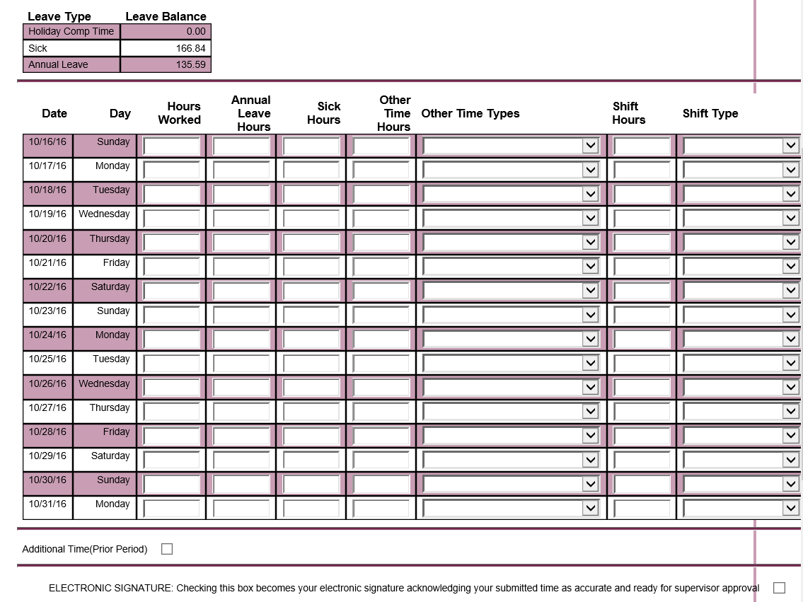
Time Entry Form
Notes:
Once you select the payroll period, you will arrive at the Time Entry form. If you are a current CCU employee, this screen should look familiar to you. There is one difference…your regular work hours have not been pre-populated. As a salaried, non-exempt employee, you MUST enter your actual hours worked and leave taken during the payroll period.
You should enter all hours worked each day in the first column labeled “Time Worked”. It is also necessary for you to report any eligible leave taken in the appropriate column. Leave other than annual and sick leave should be entered in the “Other Time Hours”. You must also identify and select the type of leave taken in the “Other Time Types” column.
It is expected that you will update your work hours and/or leave taken on a daily basis. Click Submit to save any changes you have made to your time entry.
At the end of the payroll period, you must electronically sign and submit your time entry form. There is a section at the bottom of the screen shot above that says ELECTRONIC SIGNATURE. At the end of that line, there is a small blank box. Click on that box so a check mark appears. Then click Submit. This must be done before the “employee cut-off” date and time. Once you electronically sign your time entry form, you CANNOT enter additional time. If changes are needed, please contact your supervisor immediately.
If there is time that needs submitted for a prior pay period, a manual time sheet for each pay period will need to be filled out by the employee, signed by both the employee and supervisor, and routed to payroll. Once payroll receives the manual timesheet, it will be paid on the next pay period.
Payroll schedules can be found on the payroll website at www.coastal.edu/payroll. On the left hand side, click on pay schedules. Then you will see options at the side for the Bi-weekly or Semi-monthly payrolls. Click on the appropriate one and you will be able to see all deadlines relating to each pay period for the calendar year.

Slide 23
Reporting Hours Worked
You must report all hours worked each day.
The system will automatically compute overtime.
Notes:
As a salaried, non-exempt employee you MUST report all hours worked each day. This includes hours worked between 37.5 hours and 40 hours and all hours worked over 40. For example, if you are scheduled to work 7.5 hours and you are approved to work 12 hours that particular day, you must report 12 hours for that day on your time entry form.
If you worked over 40 hours in a specified work week, the system will automatically compute overtime.

Slide 24
Payroll FAQs for Salaried, Non-Exempt Employees
What happens if I don’t complete my electric time/leave form by the deadline?
Will my pay be impacted in any way?
Notes:
What happens if I don’t complete my electric time/leave form by the deadline?
If you do not complete your electronic time/leave form by the deadline, your payment may be delayed.
What happens if I miss my cut-off date to submit my time/leave?
There are employee and supervisor cut-offs for time submittal each pay period. As an employee, if you miss your cut-off date and the supervisor cut-off date hasn’t expired, you may contact your supervisor to make the appropriate changes to your time/leave. If the supervisor cut-off has expired, please contact payroll to make the appropriate adjustments. Cut-off dates for time submittal can be found by going to www.coastal.edu/payroll and clicking Pay Schedules. Then select the appropriate pay cycle (Bi-weekly or Semi-monthly).
Will my pay be impacted in any way?
Your regular salary amount will be paid as it normally would, provided you report time worked and/or paid leave taken. Exception: If you fail to enter your time or leave for the payroll period in a timely manner or you do not enter enough time worked during the full payroll period, you may not receive a full payroll check.
Please remember that it is YOUR responsibility to enter all time worked and leave prior to the designated deadlines.

Slide 25
Payroll FAQs for Salaried, Non-Exempt Employees
How can I make sure that my pay processes correctly?
Who can I call if I have any questions about time and/or leave reporting?
Notes:
How can I make sure that my pay processes correctly?
Enter your time/leave in WebAdvisor timely.
Make sure that you don’t miss reporting hours or leave for any days that you are scheduled to work.
Remember to electronically sign your time entry form and then click submit.
Check with your supervisor if you do not receive an email from your supervisor/authorized processor indicating that your electronic time/leave form has been approved.
Who can I call if I have any questions about time and/or leave reporting?
You are welcome to contact the Payroll Office for assistance.
Kristen Toben – Director of Payroll X2752
Vicky Gore – Senior Payroll Accountant (for the Semi-monthly pay cycle) X2049
Jill Conway – Senior Payroll Accountant (for the Semi-monthly pay cycle) X2042
Bo McNeil – Payroll Specialist (for the Bi-weekly pay cycle) X2069
Or e-mail payroll@coastal.edu and a payroll staff will respond to you as soon as possible.

Slide 26
Thank you for your participation in this important training program!
Notes:
Thank you for your participation in this important training program on FLSA and time reporting. If you are transitioning to a salaried non-exempt position, please know that the Offices of Human Resources and Payroll are available to provide you with any assistance you may need.

