Slide 1
PERFORMANCE MANAGEMENT
Accessing the Employee Portal
Supervisors and employees will access the Performance Management System (EPMS) through the Coastal Carolina University Employee Portal site in PeopleAdmin
Notes:
In addition to CCU text alerts site, another important website is “Workplace.” Workplace is the HR-specific website where employees can view: announcements, personalized benefits statements, University holiday schedule, discounts, and more. The next few slides show benefits including leave information, retirement, and Life Services EAP that are available for temporary employees.

Slide 2
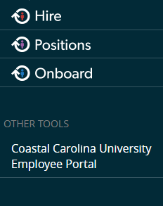
Employee Portal Homepage
Access via the Employee Portal Link https://jobs.coastal.edu/hr/shibboleth
Left side of navigation window click on three blue dots
Click on Coastal Carolina Employee Portal
Notes:
In addition to CCU text alerts site, another important website is “Workplace.” Workplace is the HR-specific website where employees can view: announcements, personalized benefits statements, University holiday schedule, discounts, and more. The next few slides show benefits including leave information, retirement, and Life Services EAP that are available for temporary employees.

Slide 3
Employee Portal, p2
Action Items – these are items for your attention, and they also work in conjunction with emails, i.e. you should receive an email for each action item.
Notes:
In addition to CCU text alerts site, another important website is “Workplace.” Workplace is the HR-specific website where employees can view: announcements, personalized benefits statements, University holiday schedule, discounts, and more. The next few slides show benefits including leave information, retirement, and Life Services EAP that are available for temporary employees.

Slide 4
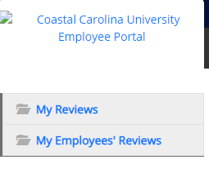
Employee Portal, p3
My Reviews and My Employees Reviews (supervisors only)
Clicking on My Reviews will provide a view of your reviews
Clicking on My Employees Reviews will provide a supervisor a dashboard display of all employees and the status of their reviews.
Notes:
In addition to CCU text alerts site, another important website is “Workplace.” Workplace is the HR-specific website where employees can view: announcements, personalized benefits statements, University holiday schedule, discounts, and more. The next few slides show benefits including leave information, retirement, and Life Services EAP that are available for temporary employees.

Slide 5
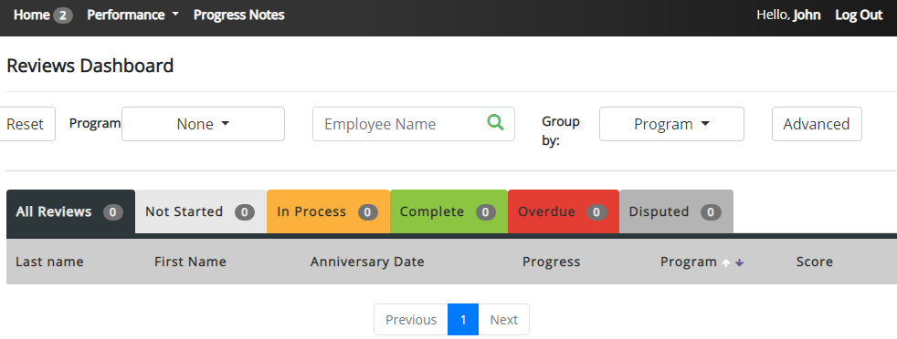
Employee Portal, p4
Reviews Dashboard
Notes:
In addition to CCU text alerts site, another important website is “Workplace.” Workplace is the HR-specific website where employees can view: announcements, personalized benefits statements, University holiday schedule, discounts, and more. The next few slides show benefits including leave information, retirement, and Life Services EAP that are available for temporary employees.

Slide 6
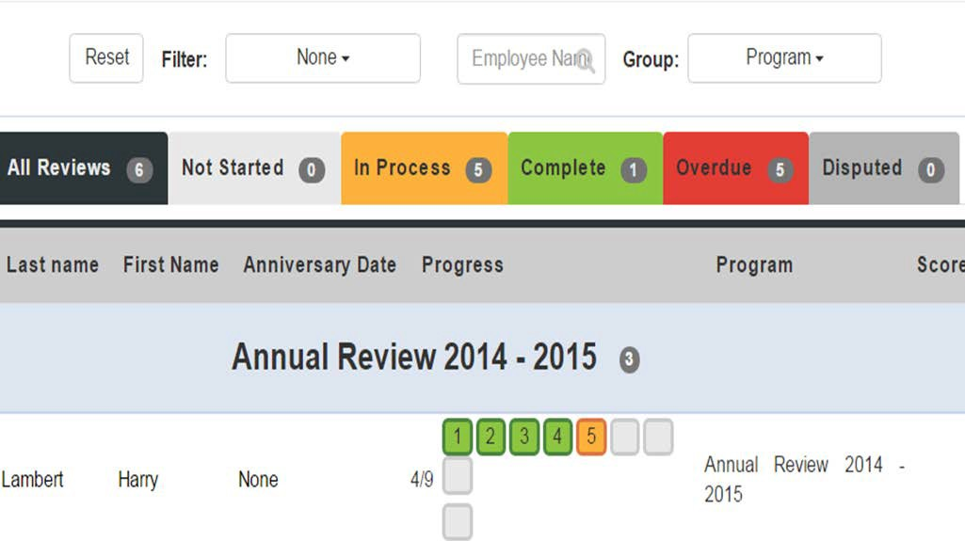
Dashboard Views
Filter – Program type (i.e. Universal, Probationary, Short Term)
Keyword Search – Employee Name
Two Available Views – Status of all employees to a given supervisor and individual tasks for an employee (by clicking on the employee’s name)
Notes:
In addition to CCU text alerts site, another important website is “Workplace.” Workplace is the HR-specific website where employees can view: announcements, personalized benefits statements, University holiday schedule, discounts, and more. The next few slides show benefits including leave information, retirement, and Life Services EAP that are available for temporary employees.

Slide 7
Searching Reviews
My Employees’ Review are only available to supervisors
Search results columns are non-configurable
Status is displayed real-time for all review and can be displayed by status
Notes:
In addition to CCU text alerts site, another important website is “Workplace.” Workplace is the HR-specific website where employees can view: announcements, personalized benefits statements, University holiday schedule, discounts, and more. The next few slides show benefits including leave information, retirement, and Life Services EAP that are available for temporary employees.

Slide 8
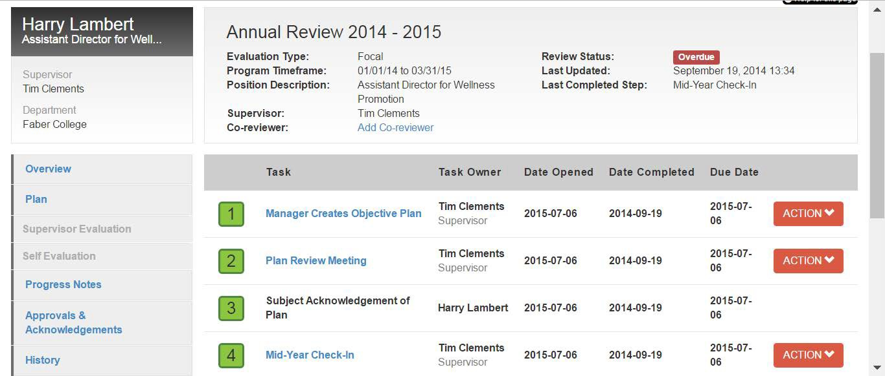
Employee and Supervisor View
Detailed information on the tasks are viewable
ACTION tab includes buttons for available actions
Notes:
In addition to CCU text alerts site, another important website is “Workplace.” Workplace is the HR-specific website where employees can view: announcements, personalized benefits statements, University holiday schedule, discounts, and more. The next few slides show benefits including leave information, retirement, and Life Services EAP that are available for temporary employees.

