Slide 1
The LiveWell Office
Staff Senate
September 13, 2022

Slide 2
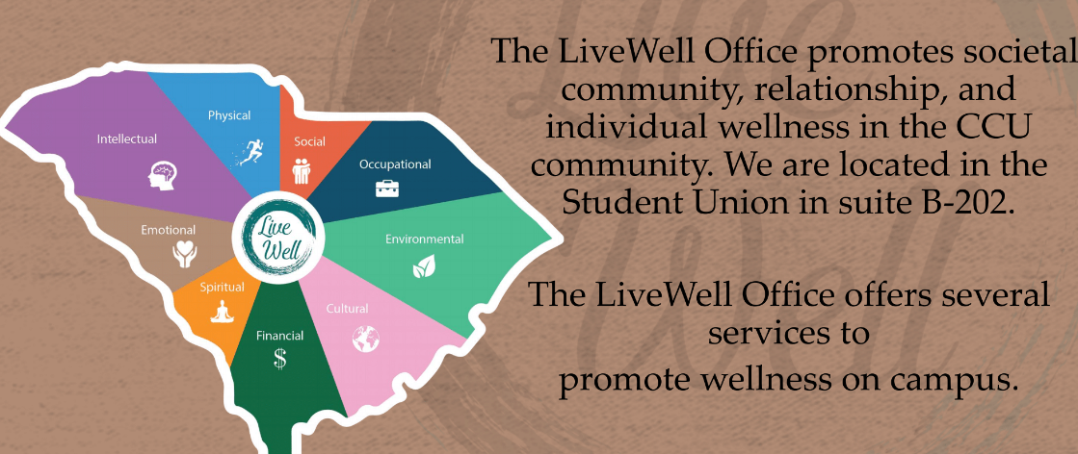
Our Mission

Slide 3
LiveWell Office Services
Campus-wide wellness initiatives
Educational Events & presentations
Online resources (YOULiveWell site, Timelycare MD app)
Interpersonal Violence Prevention & Advocacy
Alcohol Screening, Intervention, and Recovery Support services
Internships & Service Learning
Nutrition Consulting

Slide 4
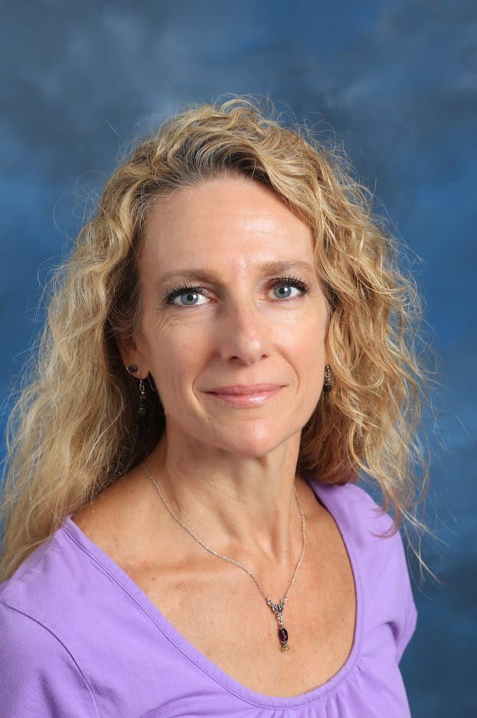
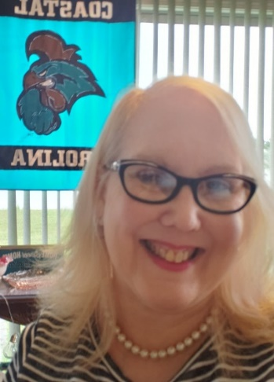
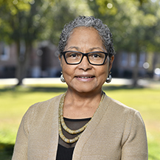
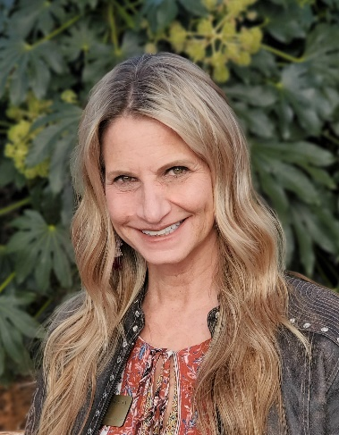
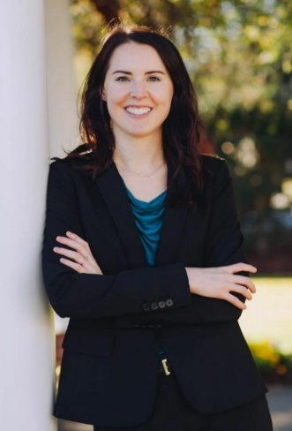
The LiveWell Staff
Pictured from Left to right:
Marguerite O’Brien, MSW, Director
Chris Donevant-Haines, MA, LPC, Associate Director
Bevelyn Mitchell, MSHS, Assistant Director
Tena Nardin, MS, LPC, Assistant Director
Molly Ford, RD, LDN, Registered Dietitian
Brandi Washell, Administrative Coordinator (not pictured)

Slide 5
Campus Wellness Initiatives: StepUP
Step UP! is a prosocial behavior and bystander intervention program that educates students to be proactive in helping others. The goals of Step UP! are to:
Raise awareness of helping behaviors
Increase motivation to help
Develop skills and confidence when responding to problems or concerns
Ensure the safety and well-being of self and others

Slide 6
Campus Wellness Initiatives: Chant Safe

Slide 7
Campus Initiatives: TimelyCare
Easily Find Care
From an uncomfortable skin condition to stress about your exam, TimelyMD makes it easy to find the medical care or emotional support you need to thrive
Book an Appointment
With a doctor, counselor, psychiatrist or health coach. You can book an appointment with the health professional you need
Talk to a Doctor
Share your symptoms, how you’re feeling and your goals, and they’ll provide a plan to support your health and wellness
TimelyMD is an extension of CCU’s student health, counseling services, & wellness program that provides care whenever and wherever you need it.

Slide 8
YouLiveWell Website
Youlivewell.coastal.edu is a wellness portal designed to help with the core aspects of college. It contains information and resources for your academic, professional, and personal success. It also has links to resources right here on campus.
Sign in at: youlivewell.coastal.edu

Slide 9
Question Persuade Refer
People trained in QPR learn how to recognize the warning signs of a suicide crisis and how to question, persuade, and refer someone to help
Training is available to all CCU students, faculty, & staff via Moodle
QPR training takes approximately one hour to complete and can be accessed through the TrainMoodle server at: https://train.coastal.edu/. For further instructions on accessing QPR training, please view this short screencast
The QPR mission is to reduce suicidal behaviors and save lives.

Slide 10
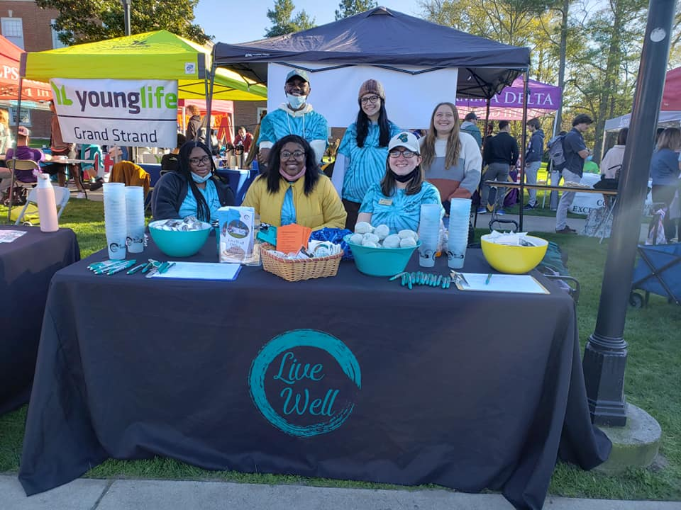
Campus Events
Sexual/Dating Violence Awareness Week (Take Back the Night, Clothesline Project & other events)
Love Your Body Day
Fall Stresstival
Wellness Week (Wellness-Palooza)
Out of the Darkness Walk for Suicide Awareness
Countdown Don’t Melt Down!

Slide 11
Peer Educator Student Organizations
Areas of focus include mental/emotional health
and wellness as well as sexual/dating/
interpersonal violence prevention
Areas of focus include all forms of health and wellness

Slide 12
Alcohol and Other Drugs (AOD)
Tobacco/Vape Free Campus
Prevention and Harm Reduction
Chants for Recovery
AOD Use-Students Perception versus Reality

Slide 13
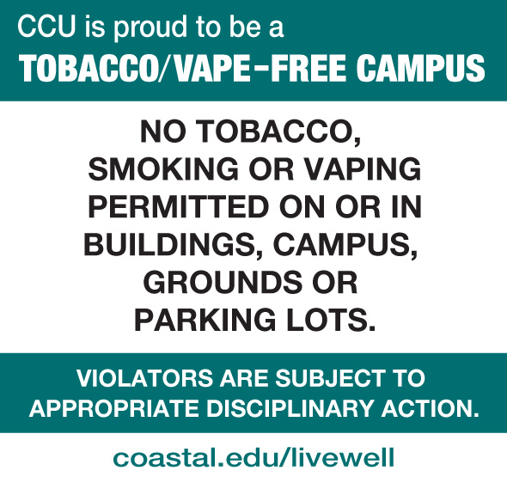
Campus Wellness Initiative: Tobacco/Vape Free

Slide 14
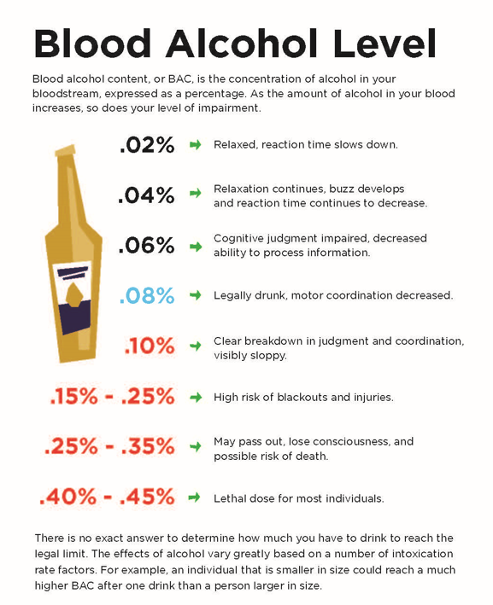
Prevention and Harm Reduction
Refer for BASICS/CASICS
Brief Alcohol/Cannabis Screening and Intervention for College Students
eCHECK UP TO GO
Outreach events
Education and support
Medical Amnesty
Notes:
help students determine their strategy for a safe, healthy and low risk lifestyle in regard to alcohol and substance use choices in order to achieve academic success and personal satisfaction (supportive, confidential, non-shaming environment).
Tom Fontana-University of Vermont

Slide 15
Chants for Recovery (CFR)
Collegiate Recovery Program (CRP) for students in or seeking recovery from substance use disorders. We are a welcoming and inclusive environment that promotes a nurturing campus and healthy community where students in recovery can achieve academic, professional and personal success.

Slide 16
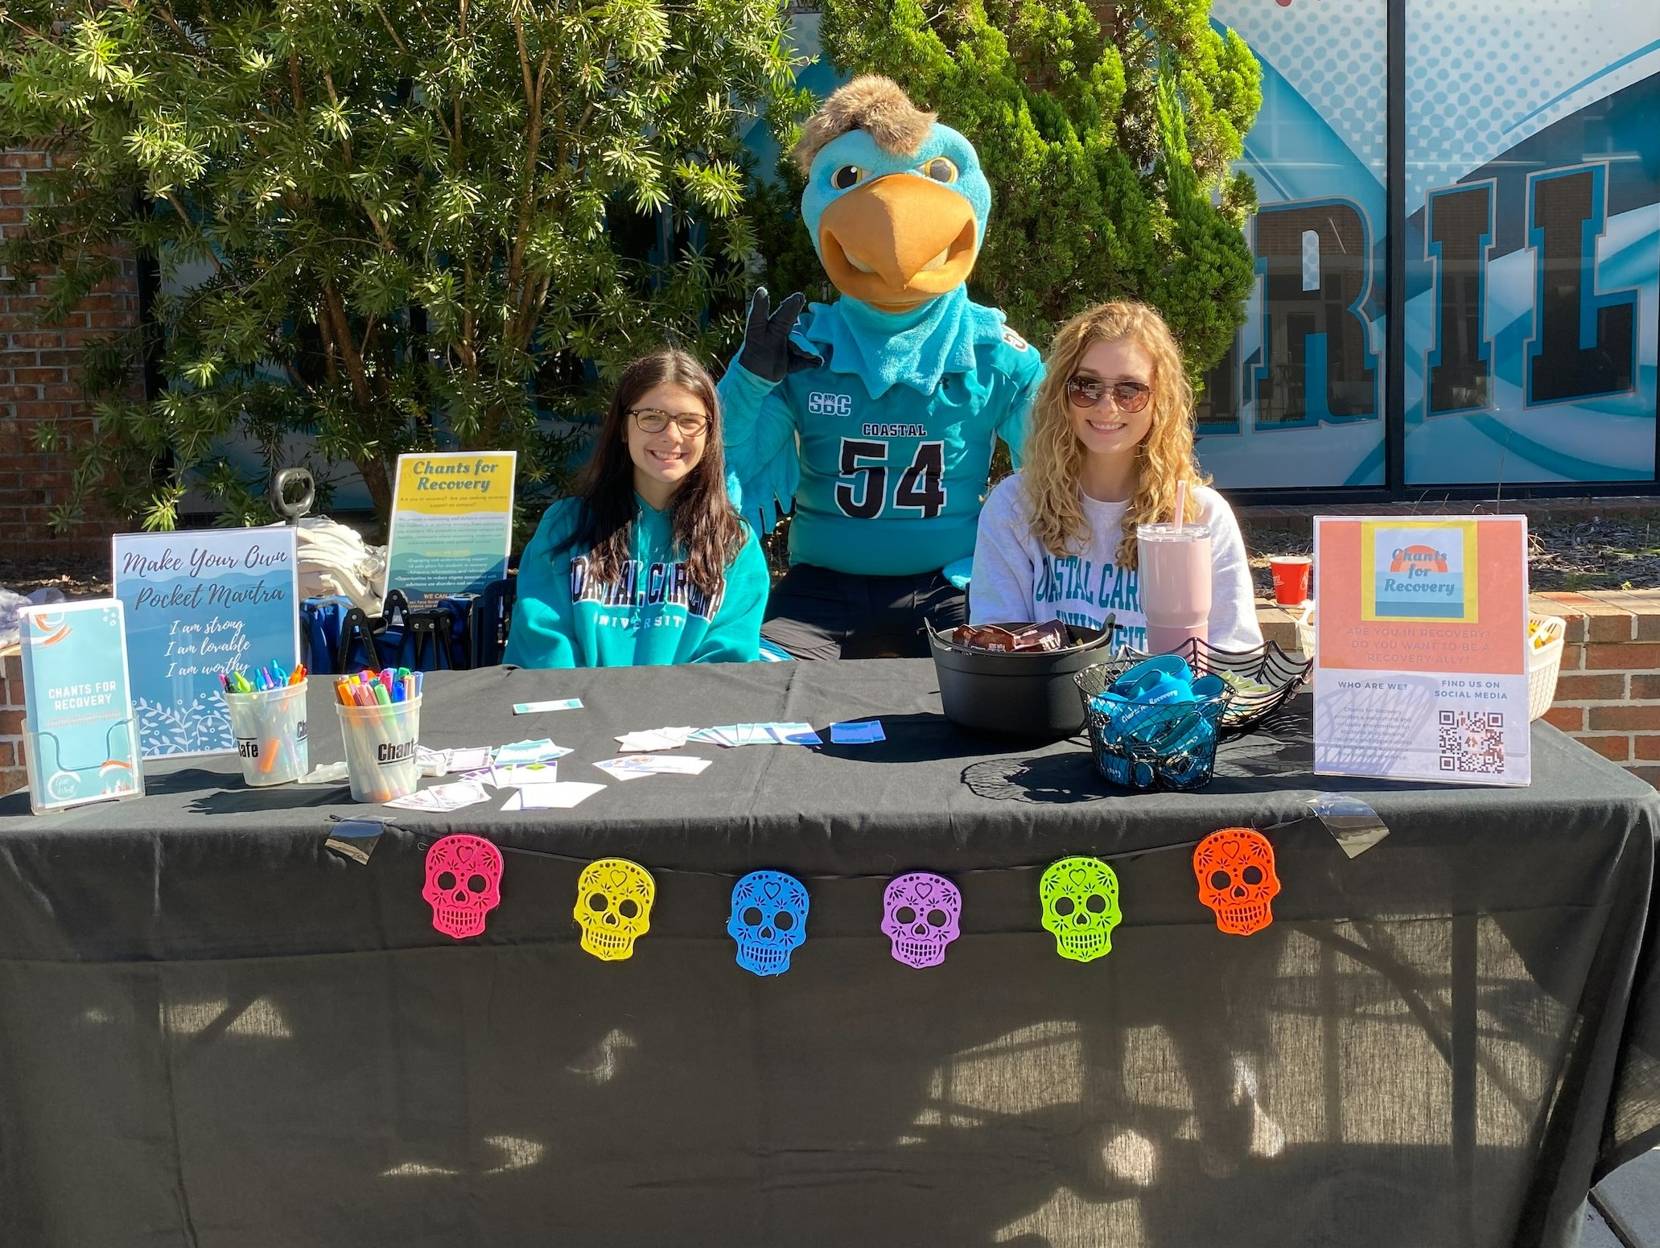
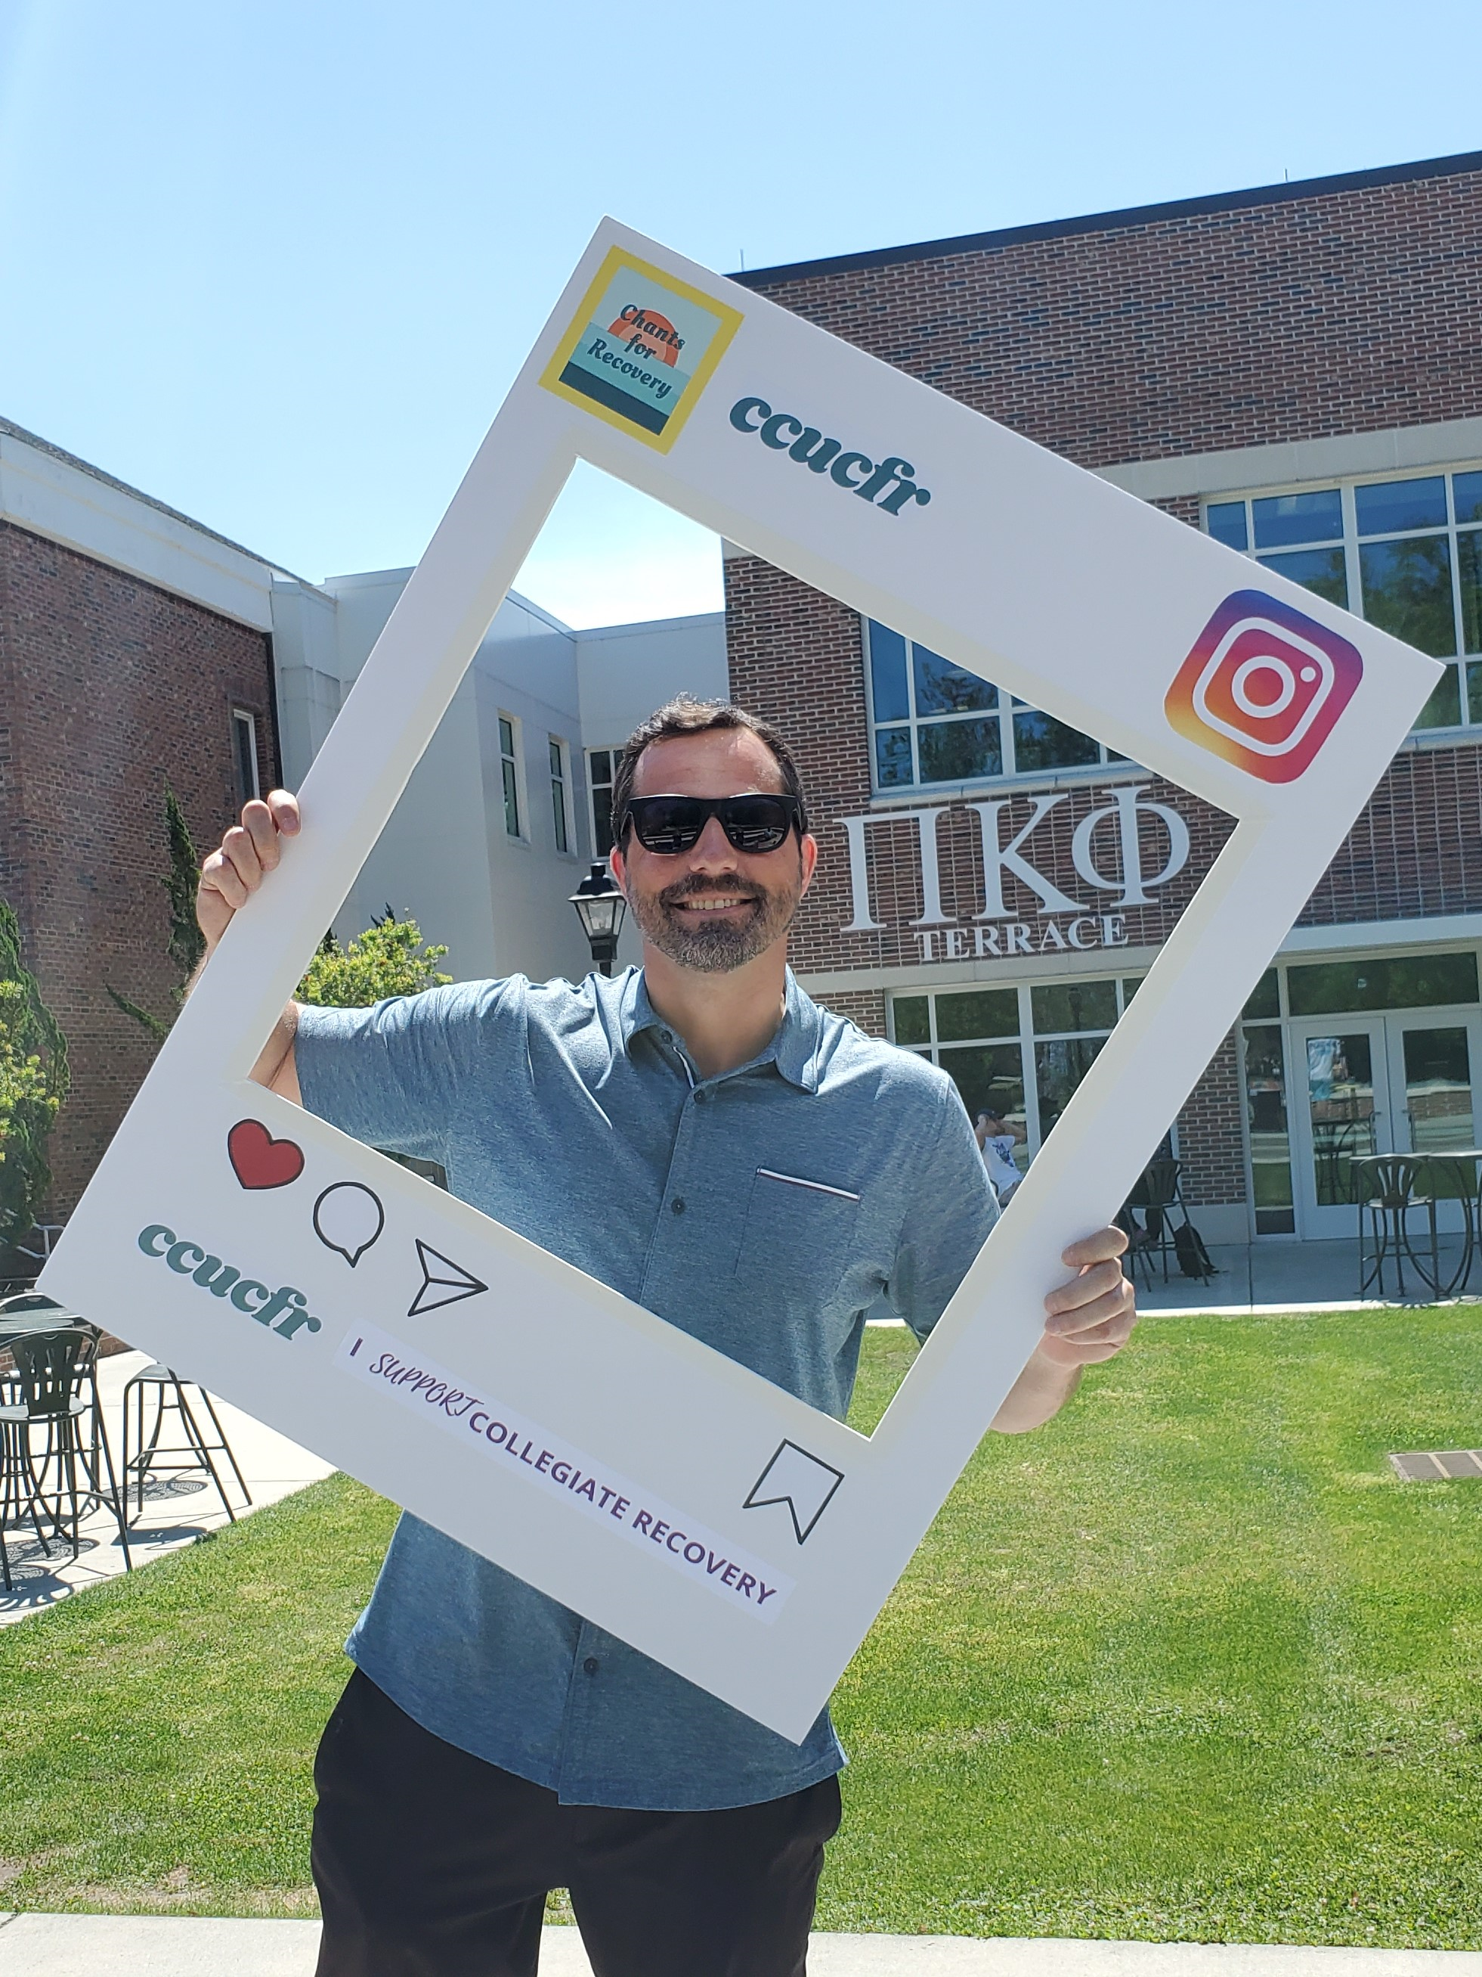
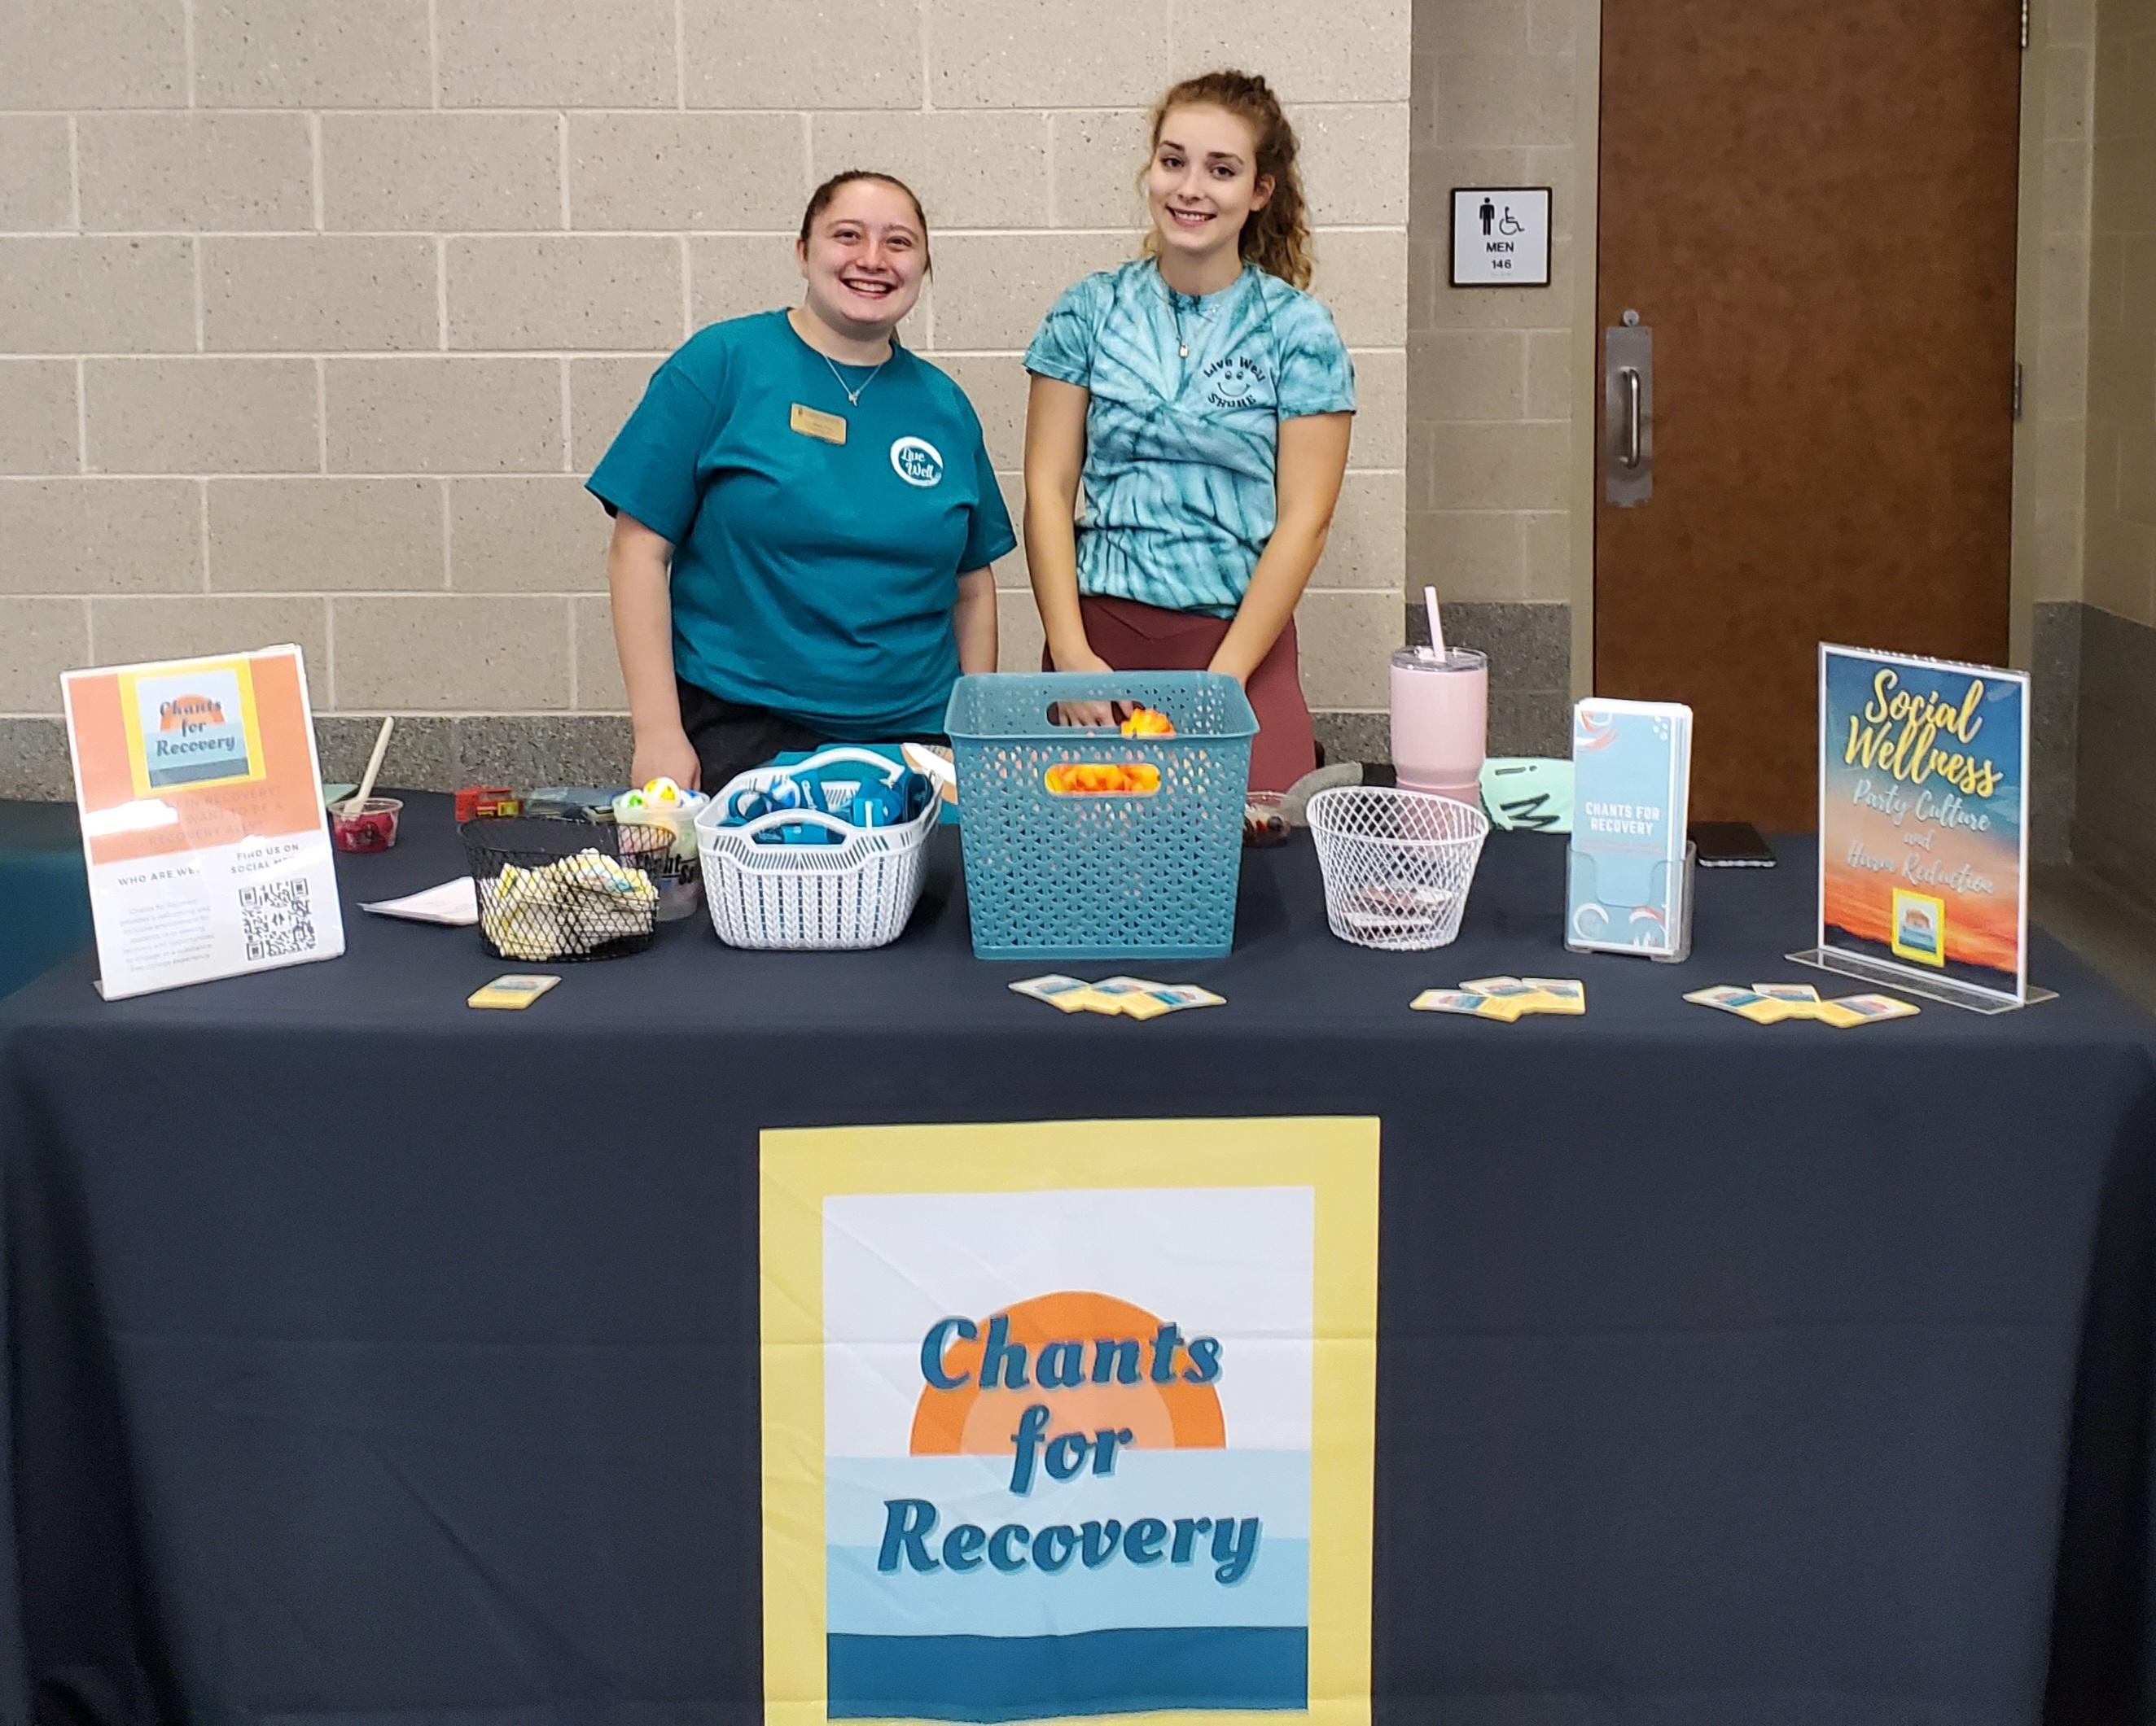
Chants for Recovery (CFR)
Our mission is to create a supportive campus community where students in recovery can thrive by:
fostering peer support & accountability
normalizing the recovery identity on campus (Recovery Ally Training)
providing information, resources, referrals & advocacy
providing a dedicated safe space
providing substance-free social activities on & off campus

Slide 17
Interpersonal Violence Support Services
Academic assistance
Consultation
Safety planning
Confidential advocacy
Accompaniment
Housing change
Notes:
The IPV mission is to provide information, support, referrals, and education about sexual and intimate partner violence (including sexual harassment, sexual assault, dating violence, and stalking), as well as consent, healthy relationships, and healthy sexuality to the Coastal Carolina community.
The LiveWell office provides outreach & awareness and prevention services. And serves as a central resource for those impacted by sexual and intimate partner violence and can assist with navigating the University’s resource and support network (including the University Counseling Center, Student Health Center, the Title IX Office, Equal Opportunity and Access, the Employee Assistance Program, and the Coastal Carolina University Police Department), as well as external support and law enforcement resources.
If you have witnessed or experienced sexual assault, stalking, harassment, or dating violence you are not alone and its not your fault. The university encourages you to speak out, report and seek support. There are various channels for you to do so. We have adopted a model that works to ensure you are supported on your terms- you are in control of what happens next.
Advocacy- We can assist you by providing information and resources that can empower you with making your own choices
Academic Assistance- We can assist with facilitating academic assistance to minimize negative academic performance
Hospital Accompaniment- A staff will go with you to the hospital for a forensic exam. We can assist you with Title IX, and meeting other appointment related to your incident
Consultation- We are available to meet with your family to explain the processes, rights, options, and resources. And to help others who may be supporting the survivor.
Safety planning- We can assist in helping to increase your physical safety and on safety including ride sharing and other secure services.

Slide 18
Confidential Advocate
Bevelyn Mitchell
Office Hours Monday-Friday 8:30am 5:00pm
LiveWell Office Lib Jackson Student Union
bmitchell@coastal.edu
843-349-2304 office
843-333-2266 confidential (office hours only)
Notes:
The student can speak to the confidential advocate regardless to where the incident occurred. CA will not disclose any information about what the student shared regarding incident. CA will listen to the student, and offer options related to the incident.
Most importantly the student will make the ultimate decision if they want to make a formal report or not. IF they CHOOSE to report… CA can assist with the following: Academic assistance: if they need to change classes, or need additional time with academic deadlines, etc.
If the student chooses to make a formal complain CA will encourage the student to answer and respond to every email from DOS and Title IX in a timely manner. Student can also request a no contact order through DOS and Title IX
Accompaniment CA will accompany the student at all meetings, and appointments related to the incident. This includes but not limited to hospital and dr appointments.
Housing change CA will also assist student with the process, of changing residents at any campus housing facility here at the university. Through DOS and Title IX CA can also assist accessing a no contact order for the safety and wellbeing of the students
Consultation- CA will NEVER disclose information to anyone about a student without a signed ROI Release of Information… that includes parents and guardians
As university housing staff it is likely that you may be the first person a students goes to when in distress
The university encourages students to speak out, report and seek support. There are various channels for them to do so. We have adopted a model that works to ensure that students are supported on their terms- and they are in control of what happens next.
You can speak with a confidential advocate, who will listen to you, believe you and talk to you about your options. We can connect the student with support services and assist in the impacts on their studies.
CA can provide information to the student decide if they want to make a formal report to the university about what has happened.
They can also report the matter to the Department of Public Safety;, we can help you do that too. Be assured we will inform you and support you every step of the way.

Slide 19
Reporting
https://cm.maxient.com/reportingform.php?CoastalCarolinaUniv&layout_id=2
Dean of Student office
Title IV office
Victim advocate DPS
Notes:
IPV page is still under construction: We will let you when the updates are completed. All of the information shared
URGENT: This is a friendly reminder, if you think a student is about to disclose sexual assault, remind them that you are a mandated reporter, and let the student know, if they would prefer to speak to a confidential advocate assist the student in making the call.

Slide 20
Medical Amnesty
Underage drinking
Medical emergency related to alcohol or drug consumption
Neither the student making the contact nor the student in need of assistance will be charged with a student conduct violations of the University Alcohol and Drug Policy
Notes:
When a student contacts CCU Public Safety, a member of the University Housing staff, or an off-campus law enforcement personnel (for off-campus incidents) regarding a medical emergency related to alcohol or drug consumption, neither the student making the contact nor the student in need of assistance will be charged with violations of the University Alcohol and Drug Policy.
This is referred to as medical amnesty.

Slide 21
Identifying students in Distress
LiveWell office and the university Counseling Center have partnered to offer this training to help faculty and staff learn how to identify and support students in distress, who may have or be experiencing power-based personal violence, need support related to substance abuse or mental health.
Notes:
In addition to the 9 dimension of wellness; LiveWell office wants you to recognize when a student may be in any stressful situation and want you to know that resources at your fingertips.
Here we will reiterate IPV services and campus resources.

Slide 22
How to support a survivor
Notes:
It’s not always easy to know what to say when someone tells you they’ve been sexually assaulted, especially if they are a friend or family member. For a survivor, disclosing to someone they care about can be very difficult, so we encourage you to be as supportive and non-judgmental as possible.
Again I cant stress enough to encourage her/him/they to reach out to the confidential advocate.

Slide 23
Examples of supportive things to say:
I believe you
You’re not alone
It’s not your fault
I’m sorry this happened
Notes:
Sometimes support means providing resources, such as how to reach the Confidential Advocate.
Some supportive things you can say:
“I believe you. It took a lot of courage to tell me about this.” It can be extremely difficult for survivors to come forward and share their story. They may feel ashamed, concerned that they won’t be believed, or worried they’ll be blamed. Leave any “why” questions or investigations to the experts—your job is to support this person. Be careful not to interpret calmness as a sign that the event did not occur—everyone responds to traumatic events differently. The best thing you can do is to believe them.
“It’s not your fault. You didn’t do anything to deserve this.” Survivors may blame themselves, especially if they know the perpetrator personally. Remind the survivor, maybe even more than once, that they are not to blame.
“You are not alone. I care about you and am here to listen or help in any way I can.” Let the survivor know that you are there for them and willing to listen to their story if they are comfortable sharing it. Assess if there are people in their life they feel comfortable going to, and remind them that there are service providers who will be able to support them as they heal from the experience.
“I’m sorry this happened. This shouldn’t have happened to you.” Acknowledge that the experience has affected their life. Phrases like “This must be really tough for you,” and, “I’m so glad you are sharing this with me,” help to communicate empathy.
There’s no timetable when it comes to recovering from sexual violence. If someone trusted you enough to disclose the event to you, consider the following ways to show your continued support.:
Avoid judgment. It can be difficult to watch a survivor struggle with the effects of sexual assault for an extended period of time. Avoid phrases that suggest they’re taking too long to recover such as, “You’ve been acting like this for a while now,” or “How much longer will you feel this way?”
Check in periodically. The event may have happened a long time ago, but that doesn’t mean the pain is gone. Check in with the survivor to remind them you still care about their well-being and believe their story.
But often listening is the best way to support a survivor.

Slide 24
Know your resources
Local resources
National resources
CCU confidential advocate 843-333-2266
Rape Crisis Center 843-488-7273 crisis line
National Sexual Assault Hotline 800- 656-HOPE (4673)
National Suicide Prevention Lifeline or call 800.273.TALK (8255) 24/7
Notes:
Confidential advocate is available the above number Monday-Friday 8:30am – 5:00pm 843-333-2266

Slide 25
Additional Resources
Counseling Services*
843-349-2305
www.coastal.edu/counseling
Student Health Services*
843-349-6543
www.coastal.edu/health
National Sexual Assault Hotline*
800-656-4673 online.rainn.org*
CCU Public Safety
843-349-2177
After hours: 843-349-2911
LiveWell Office
843-349-4031
livewell@coastal.edu
Title IX Coordinator
843-349-2382
titleix@coastal.edu
*confidential

Slide 26
LiveWell Office
Lib Jackson Student Union Room B-202
Email: livewell@coastal.edu
843-349-4031

Slide 27
Confidential Advocate
Notes:
The student can speak to the confidential advocate regardless to where the incident occurred. CA will not disclose any information about what the student shared regarding incident. CA will listen to the student, and offer options related to the incident.
Most importantly the student will make the ultimate decision if they want to make a formal report or not. IF they CHOOSE to report… CA can assist with the following: Academic assistance: if they need to change classes, or need additional time with academic deadlines, etc.
If the student chooses to make a formal complain CA will encourage the student to answer and respond to every email from DOS and Title IX in a timely manner. Student can also request a no contact order through DOS and Title IX
Accompaniment CA will accompany the student at all meetings, and appointments related to the incident. This includes but not limited to hospital and dr appointments.
Housing change CA will also assist student with the process, of changing residents at any campus housing facility here at the university. Through DOS and Title IX CA can also assist accessing a no contact order for the safety and wellbeing of the students
Consultation- CA will NEVER disclose information to anyone about a student without a signed ROI Release of Information… that includes parents and guardians
As university housing staff it is likely that you may be the first person a students goes to when in distress
The university encourages students to speak out, report and seek support. There are various channels for them to do so. We have adopted a model that works to ensure that students are supported on their terms- and they are in control of what happens next.
You can speak with a confidential advocate, who will listen to you, believe you and talk to you about your options. We can connect the student with support services and assist in the impacts on their studies.
CA can provide information to the student decide if they want to make a formal report to the university about what has happened.
They can also report the matter to the Department of Public Safety;, we can help you do that too. Be assured we will inform you and support you every step of the way.

