Slide 1
General Staff Meeting
Spring 2019
Presented by
David Yancey
Staff Senate President
January 29, 2019

Slide 2
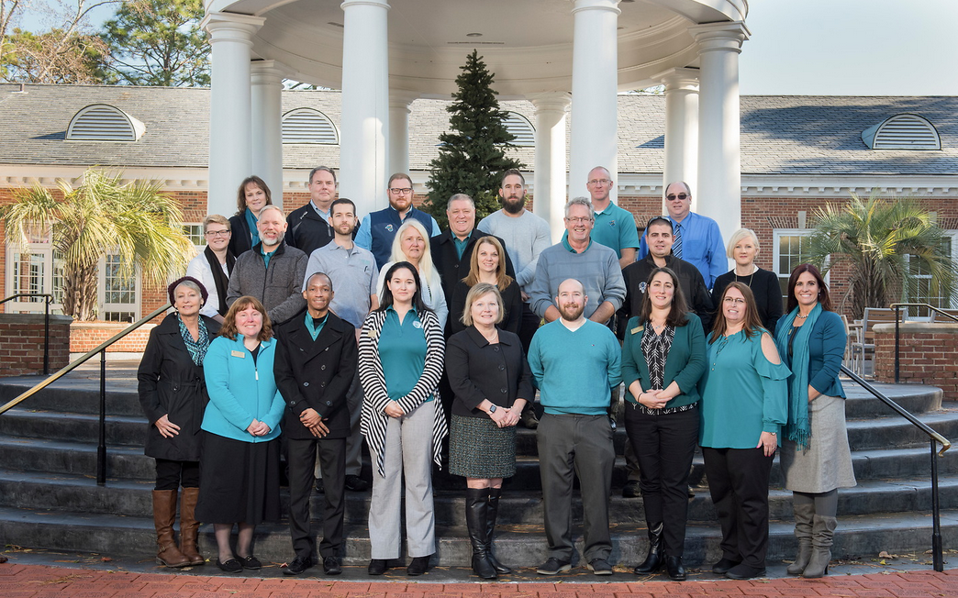
How the Staff Senate Works
Senators
Committees
Business Items
Process

Slide 3
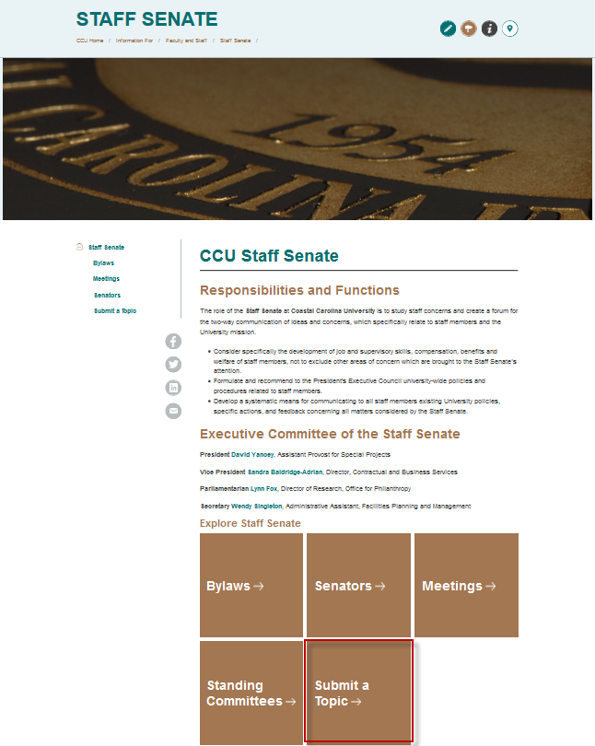
How can I participate?
Contact your Senator
Reach out to another Senator
Attend a meeting
www.coastal.edu/staffsenate
Submit a topic
When submitting a topic…

Slide 4
Submitting a Topic
www.coastal.edu/staffsenate
Policy/Process
Creation/Change
Holistic view of institutional practices
Accumulation of feedback
Steps that have been taken
Current outcomes

Slide 5
What are we working on?
Policy and Welfare Committee (John Dooley)
Staff Salary Study
Frequency
Process / Methodology
Membership Committee (Meg Hurt)
Elections process for Senators (July)
Ad Hoc Committee on Student Pay (Alli Crandell)
New minimum salary for student employment

