Slide 1
Work-Life Services
A Total
Well-Being EAP

Slide 2
Agenda:
Work Life Services
Personal Assist
Life Coaching
Resource & Referral
Child Care
Elder Care
Medical Advocacy
Legal
Financial
Life Expert
Features
Welcome

Slide 3
Work Life Services:
The Work Life Team
Work Life Services
- How they complement EAP
How employees access services

Slide 4
Personal Assist:
Definition
Helps with a caller's 'to-do' list
Helps with time management
Specialized services
Examples
Travel Assistance
Plumber
Know this:
Non-transactional

Slide 5
Life Coaching
What is it
- How it differs from counseling
Scheduling

Slide 6
Resource & Referral
Definition
Helps navigate the challenges of life
Customized guidance with a consultant
Resolution of hurdles
Examples
Child and Eldercare

Slide 7
Child Care
What it is
Licensed vs unlicensed
- How we can help with navigating unlicensed providers
Cans and Cannot's

Slide 8
Do’s
Transition Care
In-home care resources
Skilled vs Assisted Living
Safety
Don’ts
Pick a nursing facility
Insurance
Medical or legal advice
Paperwork for insurance, VA, etc.
Examples:
Discharge
POA and Advanced Directives
Covid-19
Alzheimer’s and safety
Elder Care

Slide 9
Medical Advocacy
Can
Cannot
Medical appointment preparation
Find a doctor
Advocacy/research
Discharge Planning
Insurance Navigation
Provide legal/medical advice
Select insurance
Complete paperwork for Insurance ,FMLA and First Act
Mental health providers or facilities
Empowers employees thru support/resources to navigate the healthcare system

Slide 10
Legal
Service | Benefit
Telephone | 30 minutes
In Office | 30 minutes
Discounted Services | 25%
Mediation | 30 minutes
Mediation Discount | 25%
24/7 Criminal Referral | 30 minutes

Slide 11
Family law
Civil law
Estate planning
Landlord/tenant
Real estate
Criminal
Administrative
Taxes
Bankruptcy
Probate
Bodily/personal injury
Elder abuse/law
Patents
Business
Immigration
Social security
Military law
Intellectual property
Legal Matters Covered

Slide 12
Employer/employee matters
Malpractice
Other work-related issues
Legal Matters NOT Covered

Slide 13
20,000 legal providers
8,500 physical locations
65 languages
Coverage includes all 50 States, Canada, Puerto Rico, Virgin Islands, & Guam
Attorneys and Mediators are licensed with malpractice insurance and 5 + years experience
The CLC Legal Network

Slide 14
Financial
Meet the Financial Team
Common Financial Referral Concerns
AOH Financial Counseling Model
How we can help—and where we cannot (External)
- Tax and Retirement
AOH Financial Wellness Booklet
Trainings/Presentations

Slide 15
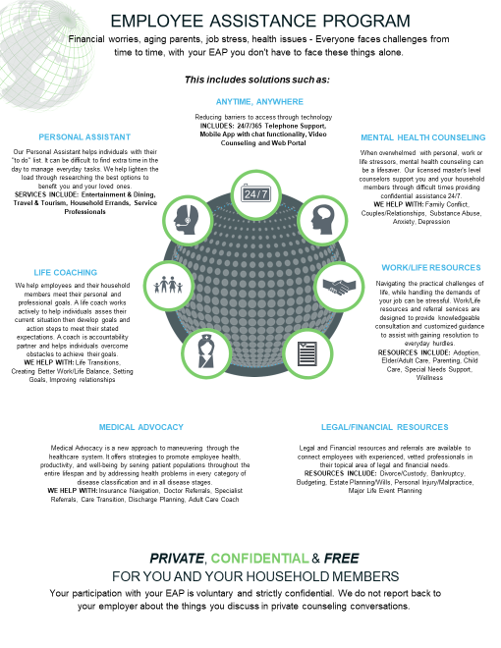
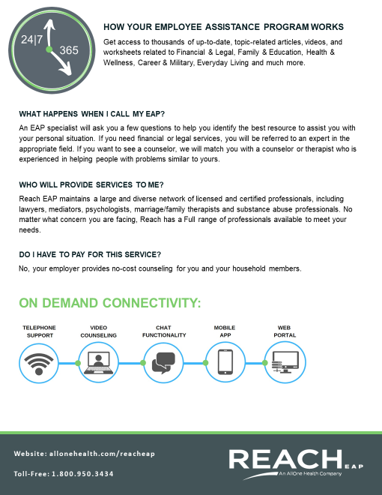

Slide 16
Life Expert- Best In Class Well-Being Portal
Our brand new, game-changing mobile app and website allows users to have all the tools necessary for a healthy work/life balance, at their fingertips!
MY LIFE EXPERT ALLOWS YOU ACCESS TO:
THOUSANDS of articles, videos, and worksheets
Quick Health and Lifestyle assessments and surveys
Interactive checklists
Events Calendar for the latest webinars and online training sessions
Your company's HR info and company-wide alerts
Build your own Employee Profile
24/7 instant, confidential support

Slide 17
Questions?

